Slide 1
Data Engineering
(Refresher)

Slide 2
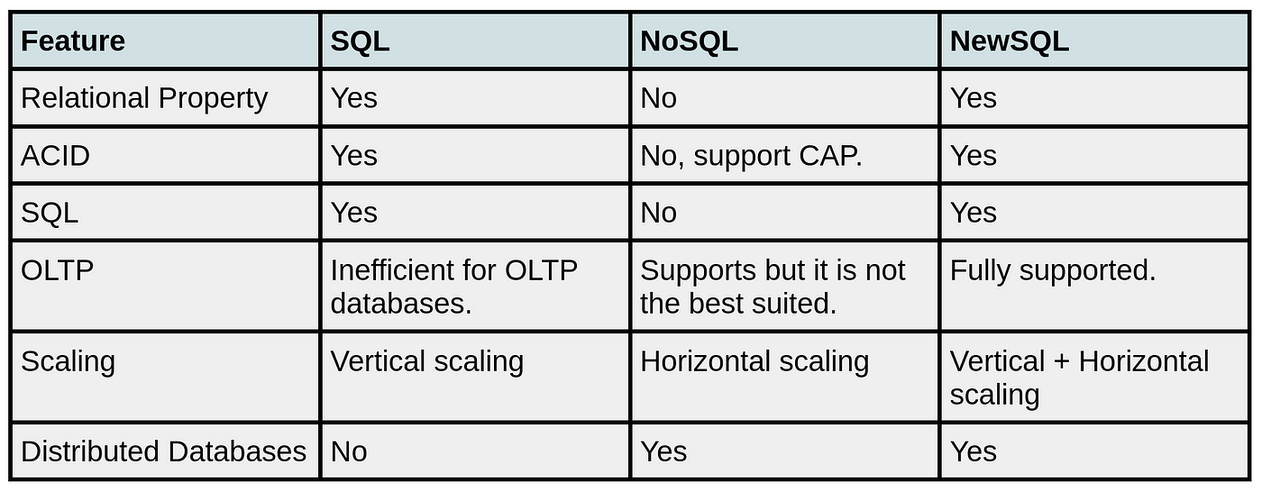
Polyglot Persistance
Selecting DBs(for Polyglot Persistence) based on DB Relationships[Discussion] –
One-to-One & One-to-Many(& Data Locality)
Many-to-Many
SQL vs NoSql vs NewSql(a new RDBMS type)
Key Value – Mainly used for Application Cache or Session data
Document DB –In DDD terms, it seems if the relation is between some entity & value object(s) & it’s 1-to-1 or 1-to-many, then we can go for using such DB but else better to go with RDBMS(else the docs may have repetitive/redundant data).Also mind it, each doc has size limitations & the docs collection as well has size limitations.

Slide 3
Polyglot Persistance
NoSql Types –
Columnar DBs –
DWs using Facts & Dimensions[usually denormalized] [Discussion]
Relational & Modern DWs based on Row and Column Oriented DBs[Discussion]
Spatio- Temporal DBs – For this, PostGresSQL/PostGIS is a good general purpose option while GeoMesa & other specialized options(e.g. SpaceTime) offer advantages for very large datasets or specific analytical requirements.
Graph DB – Can be mainly used for Semantic Data Modelling i.e. modelling data not only to show the data but also its meaning via relationship between data e.g. sequential data(e.g. DNA sequences or to store the relationship between words/sentences etc in text[this technique is heavily used in Natural Language Processing]), hierarchical data or some other complex relational data as well
(Multi-Modal) Search DB – Mainly used for (multi-modal[text/images/videos]) search. State-Of-The-Art technique is to use Embeddings based Vector DBs.
N.B.-> For Many-to-Many DB relationships better to opt for an RDBMS(preferably NewSql based) since in this case no much point of having cross data locality using Document DB(in-fact that ultimately leads to worse performance & worse maintainability).
For Further Exploration –
Which DB to use ?
In Memory Data Structures Representations In DB
Time Series Databases - everything you need to know
Time Series Database - Amazon Timestream – AWS
MetricsDB: TimeSeries Database for storing metrics at Twitter
CRUD Database - Amazon Quantum Ledger Database (QLDB) - AWS

Slide 4
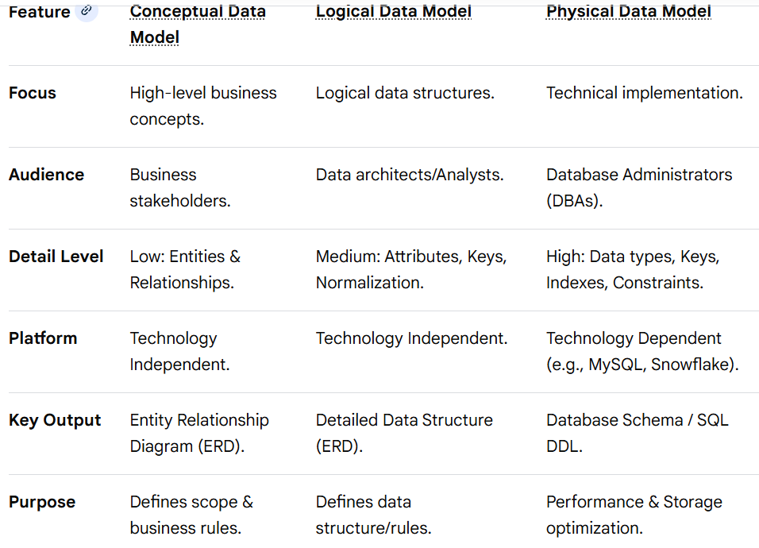
Data Modeling
Data modeling progresses through three main stages: Conceptual (high-level business view), Logical (structured, platform-independent) and Physical (specific technical implementation). Conceptual defines "what" data is needed, logical organizes attributes and relationships, and physical defines "how" it's stored using specific technology, indexes, and constraints.

Slide 5
Data Modeling
ER(Entity Relationship) Diagram for RDBMS
An Entity-Relationship Diagram (ERD) is a visual, high-level structural model of a database that maps out relationships between entities (people, objects, concepts) and their attributes, acting as a blueprint for relational database design. It uses symbols like rectangles for entities, diamonds for relationships, and ovals for attributes to represent data structure.
Core Components of an ERD
Entities (Rectangles): Represent tables or objects, such as "Customer," "Product," or "Order".
Attributes (Ovals/Fields): Describe characteristics of an entity, such as "Customer Name" or "Email".
Relationships (Diamonds/Lines): Indicate how entities connect, such as "Customer" places "Order".
Cardinality (Crow's Foot/Numbers): Defines numerical constraints (e.g., one-to-one, one-to-many, many-to-many).
Common Notations
Chen’s Notation: Uses rectangles for entities, diamonds for relationships, and ovals for attributes.
Crow’s Foot Notation: A more detailed, standard notation using lines and symbols to define cardinalities, often used in software engineering.
Benefits of Using ERDs
Database Design & Planning: Facilitates the creation of relational databases.
Reduced Redundancy: Helps in normalizing data structures.
Visualization: Simplifies complex data relationships for technical and non-technical stakeholders.
Troubleshooting: Aids in debugging existing database structures.
ERDs are essential in software engineering, business information systems, and research to map out how information flows and is stored within a system.

Slide 6
Data Modeling
NoSQL Data Model Diagram
A NoSQL data model diagram visualizes how data is structured and stored in non-relational databases. Unlike the rigid table-and-row structure of SQL (relational) databases, NoSQL diagrams focus on application-specific access patterns and flexible schemas.
There are four primary NoSQL data models, each represented by a different type of diagram:
1. Document Model
This model stores data in JSON, BSON, or XML documents. A diagram typically shows nested objects (hierarchical data) rather than separate linked tables.
Key Concept: Data that is "read together" is "stored together" (embedding).
Example: A User document containing an array of Orders.
2. Key-Value Model
The simplest form, where every item is a key-value pair. The diagram looks like a basic two-column map or dictionary.
Key Concept: Extremely fast retrieval using a unique identifier.
Example: Session_ID : {User_Data}.
3. Wide-Column (Column Family) Model
This model organizes data into columns rather than rows, grouped into "column families". Diagrams often show a table-like structure but with varying columns for each row.
Key Concept: High performance for analytical queries on massive datasets.
Example: Storing log data where different logs have different attributes.
4. Graph Model
Focuses on relationships between data elements. The diagram uses nodes (objects), edges (relationships), and properties (metadata).
Key Concept: Ideal for complex interconnected data like social networks or recommendation engines.
Example: Person A —friend of—> Person B.

Slide 7
Data Modeling
NoSQL Data Model Diagram
Key Differences from SQL (ERD) Diagrams
De-normalization: NoSQL diagrams often show duplicate data across documents to avoid expensive joins.
Schema-less: Diagrams are often "logical" or "physical" representations because the database itself doesn't enforce a fixed schema.
Query-First Design: While SQL diagrams are built around entities, NoSQL diagrams are designed around the specific queries the application needs to run.
For Further Exploration
NoSQL Database Design Example
The Tao of NoSQL Data Modeling

Slide 8
Data Modeling
Data Flow Diagram
A Data Flow Diagram (DFD) is a visual, structured tool used in system analysis to map the flow of information, showing how data enters, moves through, is stored, and exits a system. It focuses on the data processes rather than control flow, utilizing four key symbols: external entities, processes, data stores, and data flows.
Key Components & Notation
External Entity (Source/Sink): Rectangles representing external users or systems that interact with the system.
Process: Circles or rounded rectangles representing transformations, activities, or actions on data.
Data Store: Open-ended rectangles (or parallel lines) representing files or databases holding data.
Data Flow: Arrows representing the movement of data between entities, processes, and stores.
Levels of DFDs
DFDs are designed to represent systems at different levels of detail:
Context Diagram (Level 0): A high-level overview showing the entire system as a single process interacting with external entities.
Level 1 DFD: Breaks down the main process from the context diagram into major sub-processes, data stores, and data flows.
Level 2 DFD: Provides further, more granular, and detailed, breakdown of specific processes identified in Level 1
.
Types of DFDs
Logical DFD: Focuses on what the system does from a business perspective (e.g., "process order") without focusing on technical implementation.
Physical DFD: Focuses on how the system is implemented technically (e.g., "program database," "paper form").
Purpose and Benefits
DFDs are crucial for documenting requirements, analyzing system functionality, and identifying inefficiencies, making them essential for system design and software engineering. They provide a clear, easy-to-understand representation for both technical developers and non-technical stakeholders.

Slide 9
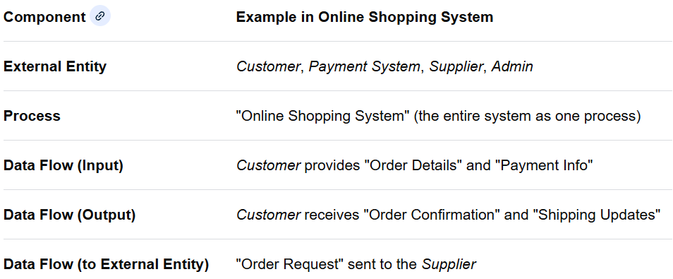
Data Modeling
Data Flow Diagram
Example: Online Shopping System
To illustrate a DFD, consider the process of a customer placing an order on an online shopping website. This example focuses on a Level 0 DFD (Context Diagram), which provides a high-level overview of the entire system as a single process.
A more detailed, Level 1 DFD would break down the single "Online Shopping System" process into major sub-processes like "Place Order," "Process Payment," and "Manage Inventory," showing data stores like an "Orders Database" and "Product Inventory". This hierarchical approach manages complexity by providing progressively deeper levels of detail.

Slide 10
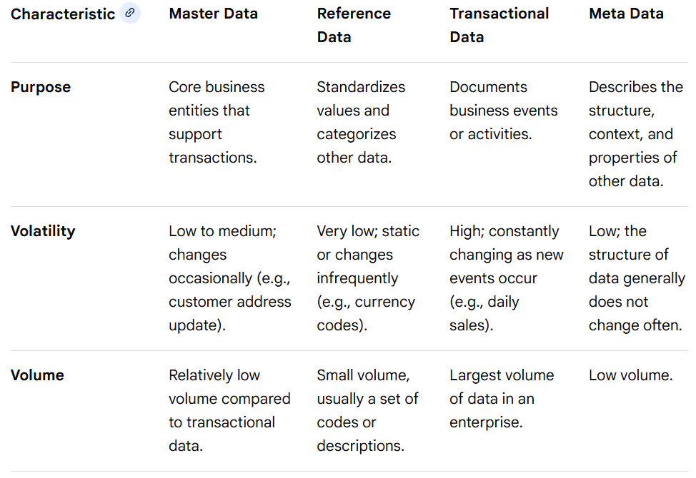
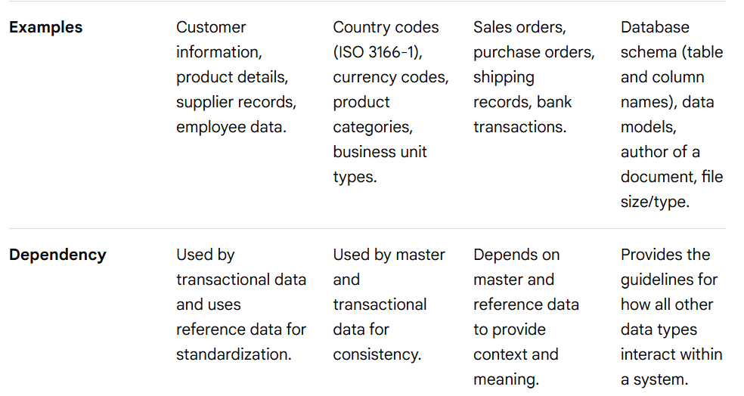
Data Modeling
Master, Reference, Transactional And Meta Data
For Further Exploration
Understanding the Overlap Between Metadata, Master Data, Reference Data and Transaction Data | LinkedIn
The four types of data | Data Sentinel

Slide 11
Data Modeling
For Further Exploration(In General)
Data Modeling Explained: Conceptual, Logical, & Physical
Introduction to relationships - EF Core | Microsoft Learn
Refactoring Databases
Database Model – jBilling
Microsoft SQL samples - SQL Server | Microsoft Learn
AdventureWorks - ER Diagram at dbdiagrams.com | HTML report
Adventureworks Database - Exercises, Practice, Solution
AdventureWorksDW
Uber-Database-Design-System
Yelp-Dataset/06_report/report.pdf at master · Tiankai-Jiang/Yelp-Dataset · GitHub
Airbnb Database Schema [classic] | Creately
Analytics Server Database Structure – Verizon Connect Enterprise Help
Dropbox DB Schema | System Design Primer
Netflix DB Schema | System Design Primer
Common Data model – Wikipedia
Common Data Model - Common Data Model | Microsoft Learn
Common Data Model - Cloud Adoption Framework | Microsoft Learn
CDM
Database schema templates by DrawSQL
Vertabelo Database Modeler
Books, an immutable double-entry accounting database service

Slide 12
Data Modeling
For Further Exploration(NoSQL Data Modelling Resources)
What is NoSQL Data Modeling? Definition & FAQs | ScyllaDB
How To Design Schema For NoSQL Data Models | MongoDB
NoSQL Data Modeling Techniques – Highly Scalable Blog
Schema design for time series data | Bigtable Documentation | Google Cloud
The DynamoDB Book -- The most comprehensive book on data modeling with Amazon DynamoDB
Data Modeling with NoSQL Database: 3rd Edition
Steve Hobberman Books | Amazon.com
Temporal and Spatio-temporal Graphs in Neo4j
For Further Exploration(NoSQL Analytics Resources)
Graph Analysis and Visualization | Wiley Online Books
Truthful Art, The: Data, Charts, and Maps for Communication
Visualizing Graph Data
Geospatial Analysis - spatial and GIS analysis techniques and GIS software.
Geospatial-Analysis-with-SQL
Learning-Geospatial-Analysis-with-Python
12 Methods for Visualizing Geospatial Data on a Map | SafeGraph
Spatio-Temporal Graph Data Analytics
N.B – For the various Chart and Graph types in above Data Visualization resources, one can google/chatgpt for sample sql queries and understand the chart/graph.

Slide 13
Database[or Related] Design Checklist
If the app is write heavy(i.e. having more inserts/updates compared to selects w.r.t DB) then go for Normalized DB design else if its read heavy then go for Denormalized DB design. Also, via CQRS pattern,, data can be written in normalized DB while can be read from denormalized DB.
Use Audit Columns like CreatedBy, CreatedOn, LastUpdatedBy & LastUpdatedOn if auditability is required.
Use Outbox(& Inbox) patterns for any integration(to external/internal APIs, MQs or DBs or File Servers)
Check if Sync(Synchronous) Transactions needed to be handled & Sync Transactions are in general needed for -
a) Bulk(multiple) items of same record/row type[i.e. within same table] needs to be
inserted/updated/deleted in an atomic way in “all or none” mode.
b) An object/record which needs to be splitted in parts & each part needs to be inserted in different
DB tables
c) Multiple operations(e.g. insert & some conditional update) needs to be done on the same record of
a table in an “all or none” mode.
d) A combination or all of a, b & c above.
N.B. - Always wrap Synchronous Transactions using UnitOfWork Pattern.
5) Check upfront if there is any usecase where the same record/row of a DB table can be (read +)
written(updated/inserted) by multiple concurrent users/requests as depicted in Concurrency Control in DBMS –
GeeksforGeeks, then various concurrency issues can occur & should be handled using Optimistic or Pessimistic
Concurrency checks. 2 common use-cases/scenarios related to this are –
a) Using integer IDs as PKs – say you read a max PK & then do new to-be inserted PK = max PK + 1 & then insert
the data with new PK. For multiple concurrent requests, concurrency issue(s) can happen here & rather than
explicitly using some optimistic or pessimistic concurrency control mechanism to handle the concurrency issue(s),
it’s better to change the DB design to use GUID based PKs instead of integer based PKs.

Slide 14
Database[or Related] Design Checklist
b) Any booking of something e.g. you want to book a hotel room A from today till next 3 days while there is
another user who wants to book the same hotel room A for tomorrow only & both the requests have come at the
same time & so concurrency is happening & that needs to be controlled/handled. Distributed Locking(How to do
distributed locking — Martin Kleppmann’s blog) on impacted rows only using some attribute/column say
LockedByUserID seems to be the best way to handle such scenario(s). But then again in this case other client
requests may have to implement Retry + Circuit Breaker Resiliency patterns or there needs to be MQ based async
layer to process requests one by one before the distributed locking comes into picture.
Have proper index being applied to fetch queries for join & where clause columns. Also check volumetrics upfront
and see if partitioning is needed for some transactional tables/collections(e.g. Cosmos Mongo has a constraint
that single default partition size cannot be > 20GB) which can grow (hugely) with time. If yes, then have the
partition key in where clause of each update and select query for such transactional tables else performance can
degrade heavily with growth of data. Purging & Archiving data based on some retention policy also can be a
solution but sometimes both Partitioning and Retention policy based implementation might be needed.
In any Data pipeline, decide upfront the data processing framework(s)/tool(s) & kind of storage to be used i.e. use
the right tool for the right job(in the right way) e.g. there can be need to use persistent storage or in-memory
storage & retention policy can be applied to both & retention period can be as low as deleting the records just
after processing or it can be very long periods of say 50 years or even more(atleast for persistent storage) as well
due to some compliance.

Slide 15
Semantic Data Modelling
Semantic data modeling creates a business-focused, structured model of data that captures its meaning, relationships, and context, acting as a layer between raw data and users for analysis. It abstracts complex underlying data structures into easy-to-understand subject areas, enabling technical and non-technical users to analyze data intuitively, integrate disparate systems, and support advanced analytics without needing to understand the technical complexity.
How it works
Capturing Meaning and Context: Semantic models focus on the "meaning" of data and its relationships within a specific domain.
Abstraction: They abstract physical database objects into logical dimensions, presenting data in a way that aligns with business understanding.
User-Friendly Layer: This model serves as a "translation layer" between the underlying data and business users.
Subject Areas and Hierarchies: Data is organized into intuitive subject areas, tables, columns, and hierarchies that reflect business structures.
Formal Knowledge Representation: Techniques like ontologies and formal knowledge representation are used to define concepts, relationships, and rules precisely.
Benefits
Improved Understanding: Makes data understandable for both technical and non-technical stakeholders.
Enhanced Analytics: Supports advanced analytical applications by exposing a metrics-oriented data layer.
Data Integration: Facilitates data integration and interoperability across different systems.
Reduced Redundancy: Helps identify and eliminate data redundancies before physical implementation.
Informed Decision-Making: Allows users to query data in an intuitive way to answer business questions and make better decisions.
Common Use Cases
Business Intelligence and Reporting: Powers dashboards, analyses, and reports by providing a structured, understandable data source.
Data Integration and Data Warehousing: Helps integrate data from various sources and supports data resource planning.
Data Science: Provides structured business logic that can be leveraged in data science applications.
Knowledge Management: Organizes knowledge explicitly and makes it queryable for multiple decision-making tasks

Slide 16
Spatio Temporal Data
Spatio-temporal data integrates both location (spatial) and time (temporal) information for objects or phenomena, allowing us to track their evolution and patterns over time and space. Common examples include GPS trajectories of moving vehicles, weather patterns, or the spread of diseases, and analyzing this data requires specialized methods to account for its unique properties like self-correlation and heterogeneity.
Key Characteristics
Dual Properties: The data explicitly captures both a geographic location (e.g., coordinates, grid cell) and a time stamp.
Dynamic Nature: Spatio-temporal objects can dynamically change their location or extent over time, like a moving car or a shifting weather front.
Autocorrelation: Nearby locations and nearby times often exhibit similar characteristics (e.g., a cluster of high temperatures in adjacent regions, according to ScienceDirect), which deviates from the independent samples assumption of traditional data mining.
Heterogeneity: The data can be diverse, with different types of spatial and temporal granularity, reflecting patterns at various levels of detail.
Types of Spatio-Temporal Data
Trajectory Data: Captures the path of a moving object, such as the route of a flight or a person's movement tracked by a mobile device.
Event Data: Records specific events that occur at a particular time and place, like a traffic accident or the outbreak of a disease.
Raster Data: Represents data as a grid, where each cell (pixel) has a value that changes over time (e.g., satellite imagery showing evolving weather conditions).
Applications
Traffic and Transportation: Analyzing traffic congestion and optimizing delivery routes.
Environmental Monitoring: Tracking climate variables and changes in natural disasters.
Public Health: Studying the spread of epidemics and their spatial correlation.
Urban Planning: Understanding population density changes and resource distribution.
Analysis Challenges
Traditional statistical and machine learning methods may not perform well on spatiotemporal data due to its complex, dynamic, and spatially dependent nature.
Analyzing these datasets requires specialized models and techniques, often involving chronological networks or deep learning and physics-guided AI, to effectively identify trends and make predictions.

Slide 17
Spatio Temporal Data Modeling
1. Data Representation Techniques
A. Grid-Based (Raster) Models[Continuous]
The space is divided into cells (regular grids), and each cell stores attribute values over time.
Common in remote sensing, climate modeling, and environmental monitoring.
Temporal modeling: Time can be handled as discrete snapshots (time series per cell) or as continuous functions.
Pros: Simple, easy to visualize and compute.
Cons: Can be memory-intensive for high-resolution grids; loses geometric detail.
B. Vector-Based Models[Discrete]
Space is represented as points, lines, or polygons, each with temporal attributes.
Example: A moving vehicle can be represented as a point with (x, y, t).
Temporal dimension can be discrete timestamps or intervals.
Pros: High geometric accuracy; good for tracking moving objects.
Cons: Complex for large datasets; harder to query efficiently.
C. Object-Oriented / Moving Object Models
Treat moving entities as first-class objects with attributes: position, velocity, and state.
Examples:
Trajectories: trajectory = { (x1, y1, t1), (x2, y2, t2), ... }
Event-based updates: Changes in object state at discrete times.
Good for tracking vehicles, animals, people, satellites.
D. Graph-Based Models
Nodes represent spatial locations, edges represent connections, and attributes evolve over time.
Useful in transport networks, social networks, disease spread.
Spatio-temporal graphs: G(t) = (V(t), E(t)) where both nodes and edges can change over time.
Enables graph analytics and path prediction.
E. Hybrid Models
Combine raster/vector, grid/graph, or object-based approaches for complex applications.
Example:
Urban mobility:
Roads → graph

Slide 18
Spatio Temporal Data Modeling
2. Temporal Modeling Techniques
Discrete time steps: Data is captured at fixed intervals (hourly traffic, daily temperature).
Event-based / asynchronous: Only record when changes occur (sensor triggers, transactions).
Continuous functions: Represent time as continuous variable; often used in physics simulations or interpolation.
Common temporal representations:
Time-stamped snapshots: Multiple static states over time.
Intervals: Start and end times for events.
Trajectories / time series: Continuous tracking of attributes over time.
3. Data Storage and Query Techniques
A. Relational + Spatio-Temporal Extensions
Spatial databases: PostGIS, Oracle Spatial.
Temporal tables: Store validity periods with spatial objects.
Query example: Find regions where temperature > 30°C during the last week.
B. NoSQL / Graph Databases
Neo4j, ArangoDB, TigerGraph for spatio-temporal graphs.
MongoDB or Cassandra for storing trajectories or time-series linked with geospatial info.
C. Specialized Spatio-Temporal Indexing
R-Trees / Quadtrees: Index spatial objects.
3D R-Trees / Time-Parameterized R-Trees (TPR-Trees): Index moving objects over time.
Space-filling curves (Z-order, Hilbert): Efficient storage and retrieval of spatio-temporal points.
4. Modeling Approaches for Analysis
A. Statistical / Probabilistic Models
Spatio-temporal autoregressive models (STAR): Predict value at location based on neighboring locations and previous time steps.
Gaussian Processes for spatio-temporal data: Continuous modeling for environmental monitoring.
B. Machine Learning / Deep Learning
RNNs / LSTMs / Transformers for time series of spatial points.
Graph Neural Networks (GNNs): On spatio-temporal graphs (e.g., traffic flow prediction).
ConvLSTM / ST-ConvNet: Convolutional + temporal modeling for grids or images over time.

Slide 19
Spatio Temporal Data Modeling
C. Simulation / Agent-Based Modeling
Useful for urban mobility, crowd movement, epidemics.
Each agent has spatio-temporal rules governing motion or interaction.
5. Visualization and Analysis
Animation over time on maps.
Heatmaps / density maps for changing spatial distributions.
Trajectory plots for moving objects.
Interactive dashboards with time sliders.
Summary Table
Technique | Spatial Type | Temporal Type | Use Case
Raster grids | Continuous | Snapshots | Climate, land use
Vector object | Points/lines/polygon | Timestamps / intervals | GIS, vehicles
Moving object | Entities | Trajectories | Transportation, logistics
Graphs Nodes/Edges | Dynamic | Edges/Nodes | Road networks, social networks
Hybrid | Mixed | Mixed | Complex urban modelling

Slide 20
Unstructured Data Modelling
Unstructured data modeling refers to the processes and techniques used to analyze and convert raw, undefined data (like text, images, and videos) into a usable format for extracting meaningful insights, often by leveraging Machine Learning (ML) and Natural Language Processing (NLP) to transform it into a structured representation that can be analyzed. This involves preprocessing the data, applying algorithms to identify patterns, and storing the transformed data in systems like NoSQL databases or data lakes to support applications like sentiment analysis, image recognition, and knowledge discovery.
Key Aspects of Unstructured Data Modeling
Data Types:
Unstructured data includes text documents, emails, social media posts, images, audio files, videos, and sensor data.
Lack of Schema:
Unlike structured data (like that in traditional relational databases), unstructured data does not adhere to a predefined data model or fixed schema.
Sophisticated Tools:
Extracting insights from unstructured data requires advanced technologies, including ML and NLP, to process the raw data.
Data Storage:
Unstructured data is often stored in file systems, NoSQL databases, or data lakes, which are designed to handle massive amounts of raw, varied data.

Slide 21
Unstructured Data Modelling
Common Use Cases
Text Analysis:
Using NLP to analyze text data from customer reviews, social media, and documents to understand sentiment and categorize information.
Image and Video Analysis:
Applying computer vision techniques for tasks like facial recognition, object detection, and content classification.
Speech and Audio Processing:
Analyzing audio data for speech recognition and to gauge voice sentiment.
Knowledge Discovery:
Uncovering patterns and relationships in unstructured data, such as common issues in customer support tickets.
Process of Unstructured Data Modeling(check the “AI, ML, DL and Related Topics” deck slides for more info)
Data Collection:
Gather large volumes of raw, unstructured data from various sources.
Preprocessing:
Clean and prepare the data, which might involve steps like tokenization for text or feature extraction for images.
Feature Extraction/Representation:
Convert the unstructured data into a structured format suitable for ML models, such as using techniques like Bag of Words (BoW) or TF-IDF for text data.
Modeling and Analysis:
Apply ML algorithms to the structured representation to perform tasks like classification, clustering, and sentiment analysis.
Insight Generation:
Leverage the results from the modeling process to gain actionable business insights.

Slide 22
Data Consolidation
Data Consolidation
Data consolidation is the process of gathering data from multiple sources and combining it into a single(or less number of DBs/Tables/Schemas etc compared to earlier state), unified location, such as a data warehouse or data lake. This unified view helps break down data silos, improves data consistency, and provides a single source of truth for reporting, analytics, and decision-making.
Key aspects of data consolidation
Combines disparate sources: It integrates data from various systems like applications, databases, and online platforms into one central repository.
Creates a unified view: By combining and standardizing the data, it provides a comprehensive overview of information, such as a retailer combining sales data from physical stores and its online platform.
Supports analytics and reporting: Consolidated data is easier to analyze, enabling better business intelligence, forecasting, and strategic decision-making.
Uses various techniques: Common methods include ETL (Extract, Transform, Load) or ELT processes to ingest, clean, and store the data.
Improves data governance: By centralizing data, organizations can better manage its security, integrity, and consistency.
Benefits of data consolidation
Better decision-making: A single source of truth leads to more informed and strategic choices.
Increased operational efficiency: Streamlines data management and reduces the time spent on reconciling inconsistent data from different sources.
Enhanced data accuracy and consistency: Centralizing data helps minimize redundancy and ensures information is standardized.
Improved data accessibility: Provides a single point of access for users across different departments.
Techniques
You can consolidate data by position or category, especially using spreadsheet tools like Microsoft Excel. Other methods include using ETL tools for complex processes or hand-coding for highly customized solutions.

Slide 23
Data Consolidation
Spreadsheet software consolidation (like Excel)
By position: Combine data from multiple worksheets that have the same layout and labels in the same order.
By category: Combine data from worksheets that may have different layouts but share the same labels (e.g., "Sales" or "Revenue"). This is similar to a PivotTable, as shown in this Microsoft Support article.
Data warehousing and business intelligence
ETL (Extract, Transform, Load) tools: Use specialized tools to extract data from various sources, transform it into a standardized format, and then load it into a central repository like a data warehouse for analysis. This is best for batch processing and historical data.
Custom solutions
Hand-coding: Write custom scripts to extract, transform, and load data. This method offers high customization but requires technical expertise.
For Further Exploration
What Is Data Consolidation? Process, Techniques & Types | Rivery
Data Consolidation Techniques | LinkedIn

Slide 24
OLAP & Dimensional Modeling
OLAP(Online Analytical Processing) is different from OLTP(Online Transaction Processing) in the sense that OLAP deals with large amount of data rows/records of table(s) within some DB(mainly reading thousands/millions or even billions/trillions, mainly in the form of some aggregate[s]) while OLTP deals with very few reads/writes(most of the times effecting only a single record in the DB) via normal sql selects/inserts/updates(or some equivalents e.g. in NoSql). Being read heavy, OLAP DBs are in general denormalized. To transfer the data from OLTP to OLAP, various (Real Time) ETL(Extract Transform Load)/ELT(Extract Load Transform) techniques & strategies can be used e.g. doing nightly bulk/batch ETL to transfer data from a OLTP DB to a OLAP DB. This process is a type of Data Migration only ultimately.
Dimensional data modeling organizes data into a star schema or snowflake schema for analytical purposes, using fact tables to store business process metrics and dimension tables for business context (who, what, when, where). Developed by Ralph Kimball, this technique is optimized for fast data retrieval in data warehouses and business intelligence systems, making complex data understandable and usable for generating insights.
Key Concepts
Fact Table:
Contains quantitative measurements (facts) from a business process, such as sales, and connects to one or more dimension tables.
Dimension Table:
Stores descriptive attributes (dimensions) that provide context to the facts, like details about products, customers, or time.
Star Schema:
A common structure where a central fact table is surrounded by multiple dimension tables, resembling a star's points.
Denormalization:
Dimensional models intentionally include redundancy to improve query performance and simplify data retrieval for analysis.

Slide 25
OLAP & Dimensional Modeling
How It Works
Identify the Business Process:
Focus on a specific area of business, like sales or customer orders.
Declare the Grain:
Define the lowest level of detail for the business process (e.g., one row per sales order line).
Identify Dimensions:
Determine the descriptive context for the facts (e.g., product, store, date).
Identify Facts:
Pinpoint the measurable data points from the business process (e.g., quantity, price, sales amount).
Build the Model:
Create fact and dimension tables, linking them with primary and foreign keys to create a structured, analytical database.
Benefits
Performance:
Optimized for fast querying and data retrieval, especially for reporting and analytics.
User-Friendly:
The structure is intuitive and easy for business users to understand and query.
Scalability:
Provides a framework for handling large datasets and complex business processes.
Business Insights:
Enables deeper analysis of trends, patterns, and performance across various business dimensions.

Slide 26
OLAP & Dimensional Modeling
OLAP cubes are used to store large amounts of data in the form of facts and dimensions tables & make them searchable in a easy & fast manner. They allow quick retrieval of data by using nested arrays to store information across multiple dimensions
For Further Exploration –
Data Warehouse Tutorial for Beginners: Learn Basic Concepts
Schemas used in data warehouses: Star, Galaxy, and Snowflake
Concepts for Data Engineers: Dimensional Data Modelling | by Cássio Bolba | Medium
Concept Hierarchy in Data Mining – GeeksforGeeks
Measures Their Categorization and Computation in Data Mining – GeeksforGeeks
Data Warehouse vs. OLAP Cube? - Stack Overflow
What is OLAP? - Online Analytical Processing Explained – AWS
Data Cube or OLAP approach in Data Mining - GeeksforGeeks
Types of OLAP Models for Databases & Data Warehouses Simplified 101 - Learn | Hevo
OLAP Functions
OLAP Operations - Scaler Topics
Understanding SSAS Multidimensional vs. Tabular Models - Saransh Inc.
Books - SQLBI

Slide 27
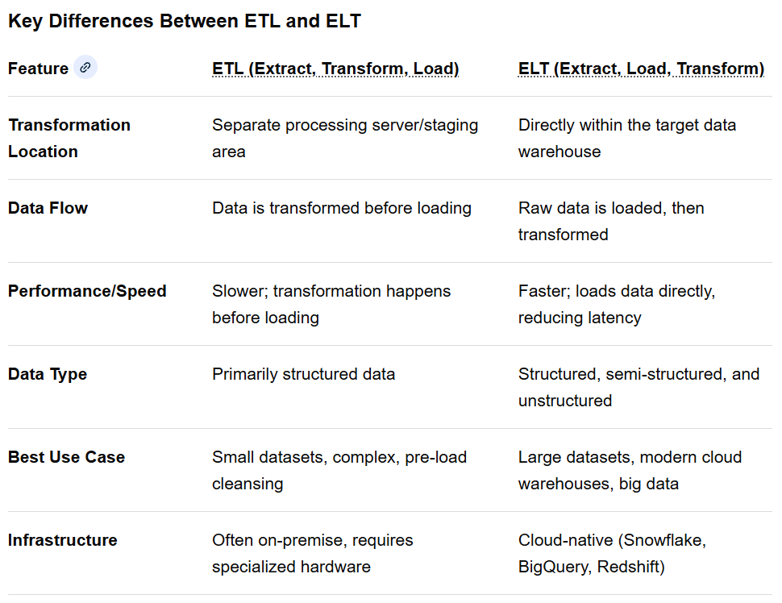
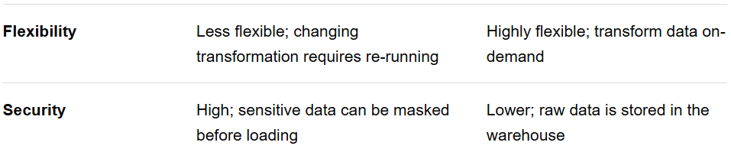
ETL vs ELT
ETL (Extract, Transform, Load) processes data in a separate staging area before loading, ideal for legacy systems and strict compliance. ELT (Extract, Load, Transform) loads raw data directly into the target warehouse, leveraging cloud scalability for faster, more flexible, and modern data processing

Slide 28
ETL vs ELT
Summary of Differences
Transformation Timing: ETL transforms data before it reaches the target, while ELT transforms it after.
Infrastructure: ELT is designed for modern cloud-based, high-performance data warehouses.
Flexibility: ELT allows for the storage of raw data for future, on-demand transformation.
Use Case: Use ETL for highly regulated data needing strict, upfront transformation. Use ELT for fast ingestion of large volumes of data (Big Data)
For Further Exploration
Why shift from ETL to ELT? - Hexanika (Think Beyond Data)
How to Build ETL Processes Using Azure Data Factory

Slide 29
(Automated) Data Reconciliation Techniques
Automated data reconciliation uses a combination of software, algorithms, and AI to systematically compare data from different sources, identify discrepancies, and enable quick resolution. Comparison can be based on counts, actual values or both and should consider “as of date” ideally.
Key techniques include:
Core Techniques
Automated Data Extraction & Normalization:
Data is automatically pulled from various sources (databases, APIs, spreadsheets) and converted into a standardized format for reliable comparison.
Automated Matching Algorithms: Software uses predefined criteria to match transactions or records across systems.
This includes:
Deterministic Matching: Requires exact matches on key fields (e.g., a specific transaction ID and amount).
Fuzzy Matching: Identifies similar, but not identical, entries (e.g., "Robert Smith" and "Bob Smith," or "McDonald's" and "McDonalds") by allowing for minor variations, typos, or different aliases.
Probabilistic Matching: Uses statistical methods to calculate the likelihood that records represent the same entity based on multiple factors, assigning a confidence score to potential matches.
One-to-many and Many-to-many Matching: Handles complex scenarios where a single transaction in one system corresponds to multiple entries in another.
Exception Management Workflows: Discrepancies or low-confidence matches are automatically flagged, categorized, and routed to the appropriate human teams for review and resolution.
Continuous Monitoring: Instead of period-end batch processes, modern techniques involve real-time or near-real-time monitoring to detect issues as they occur, preventing them from cascading into larger problems.

Slide 30
(Automated) Data Reconciliation Techniques
Advanced Techniques with AI/ML
AI-Powered Anomaly Detection: Machine learning models learn from historical patterns to identify unusual transactions or data entries that deviate from expected behavior, which might indicate errors or fraud.
Intelligent Rule Suggestions: AI analyzes past reconciliation outcomes and user input to suggest new or refined matching rules, continuously improving the automation rate over time.
Natural Language Processing (NLP): LLMs can interpret unstructured data from free-text descriptions or email attachments (like invoice details in a memo field) to extract relevant information and facilitate matching.
Implementation Best Practices
Standardize Data: Ensure consistent data formats and definitions across all source systems to minimize errors during comparison.
Implement Data Quality Checks: Validate data completeness, accuracy, and format before reconciliation to prevent bad data from entering the process.
Maintain Detailed Audit Trails: The system should log every action, discrepancy, and resolution step for transparency, compliance (e.g., SOX, GDPR), and auditing purposes.
Integrate Systems: Seamlessly connect the reconciliation platform with existing ERP, accounting, and banking systems to ensure real-time data flow and consistency across platforms.
Define Clear Governance: Establish clear policies and assign roles and responsibilities for data quality, review, and approval of exceptions.
N.B. After Reconciliation, various cleanups of various resources(DBs, DLQs etc) may be needed and after cleanup , replay also might be needed.

Slide 31
(Automated) Data Reconciliation Techniques
For Further Exploration –
A Deep Dive into Agoda's Generic Reconciliation Platform
Real Time Event Stream Reconciliation Pattern | by Rajesh Ojha | Medium
Pinecone: Data Reconciliation framework
Reconcile data with the Financial Reconciliation agent (preview) | Microsoft Learn
NLP-Powered Ledger Reconciliation With LangChain

Slide 32
(Modern) Data Architectures
A Data Warehouse stores structured, curated data for BI and reporting, while a Data Lake holds vast amounts of raw, unstructured, semi-structured, and structured data. A Data Lakehouse combines the best of both by bringing data warehousing capabilities (like ACID transactions) to data lakes. A Data Vault is a specific modeling technique for data warehouses, while a Data Fabric is an architectural approach that provides seamless data access and management across a distributed data environment. Finally, a Data Mesh is a decentralized organizational and architectural model where data is treated as a product, owned by various domain teams.
1. Data Warehouse
Purpose: Optimized for BI, reporting, and analytical queries on structured, historical data.
Data Type: Highly structured and curated data.
Schema: Schema-on-write, meaning the structure is defined before data is loaded.
Pros: Fast query performance and high data quality for specific business use cases.
2. Data Lake
Purpose:
Stores all types of data in its raw format for exploration, data science, and future, undefined uses.
Data Type:
Raw, unprocessed data, including structured, semi-structured, and unstructured data.
Schema:
Schema-on-read, allowing for flexible data analysis later.
Pros:
High storage volume at a lower cost, ideal for big data and AI/ML workloads.

Slide 33
(Modern) Data Architectures
3. Data Lakehouse
Purpose:
Unifies data warehousing and data lake capabilities into a single platform.
Data Type:
Supports both structured and unstructured data.
Schema:
Combines schema-on-write (for structured data) and schema-on-read (for raw data).
Pros:
Offers the flexibility of a data lake with the structure and advanced analytics of a data warehouse.
4. Data Vault
Purpose: A modeling technique to build a scalable and flexible data warehouse that captures historical data.
Data Type: Primarily for structured data within a data warehousing context.
Schema: Relational, but designed to handle historical changes efficiently.
Pros: Provides a robust and audit-ready solution for historical data in a data warehouse.
5. Data Fabric
Purpose: A distributed architectural approach that provides seamless data access and management across various applications, platforms, and locations.

Slide 34
(Modern) Data Architectures
Data Type: Manages data regardless of its type or storage location.
Schema: Operates across diverse data environments, enabling unified governance.
Pros: Facilitates data discovery, access, and sharing in a heterogeneous data ecosystem.
6. Data Mesh
Purpose:
A decentralized organizational and architectural paradigm where data is treated as a product, managed by domain-specific teams.
Data Type:
Supports various data types within its decentralized data products.
Schema:
Each data product team is responsible for its data's quality and governance.
Pros:
Addresses the limitations of centralized architectures by distributing data ownership, improving accountability, and fostering agility.
For Further Exploration –
Data Warehouse,Data Lake,Lake House, Data Vault,Data Fabric,Data Mesh – YouTube
Data Lakehouse, Data Mesh, and Data Fabric - James Serra - Data Toboggan - March 2023 – YouTube

Slide 35
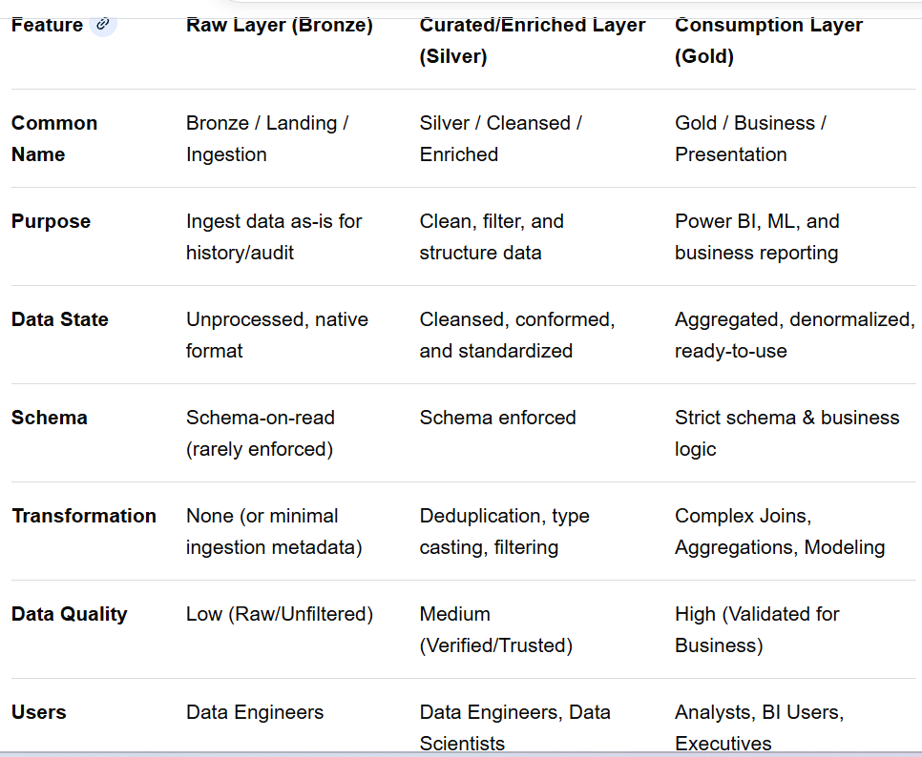
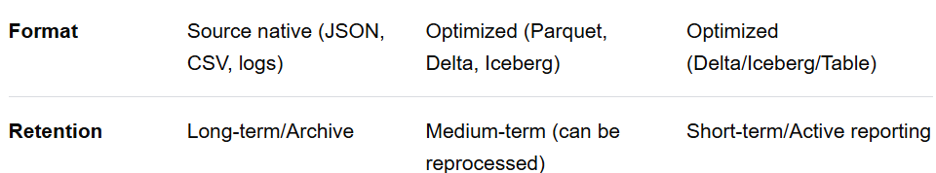
Medallion Architecture
Raw vs Curated vs Consumption Layers

Slide 36
Medallion Architecture
1. Raw Layer (Bronze)
The Raw Layer acts as the landing zone for all incoming data. It acts as the "single source of truth" or a backup that allows for complete reprocessing if business logic changes later.
Characteristics:
Immutability: No data modification allowed.
Structure: Stores data exactly as it comes from the source (e.g., IoT logs, CRM exports, Kafka feeds).
Partitioning: Often partitioned by ingestion date or source system for efficient retrieval.
Best Practices: Store files in inexpensive storage (S3, ADLS) using raw formats (CSV, JSON, XML).
2. Curated/Enriched Layer (Silver)
The Curated Layer takes raw data and transforms it into a "cleansed" state. It is the foundation for most analytical work, providing a trustworthy, validated dataset.
Characteristics:
Data Quality: Records are filtered, missing values are handled, and data types are enforced.
Structure: Data is typically converted into efficient columnar formats like Parquet or Delta Lake.
Integration: Joins data from different sources to create a unified view.
Key Operations: Renaming columns, casting data types (string to timestamp), removing duplicates, handling nulls.
3. Consumption Layer (Gold)
The Consumption Layer is designed for high-performance querying and reporting. It provides the final, business-ready data (often called "Data Products").

Slide 37
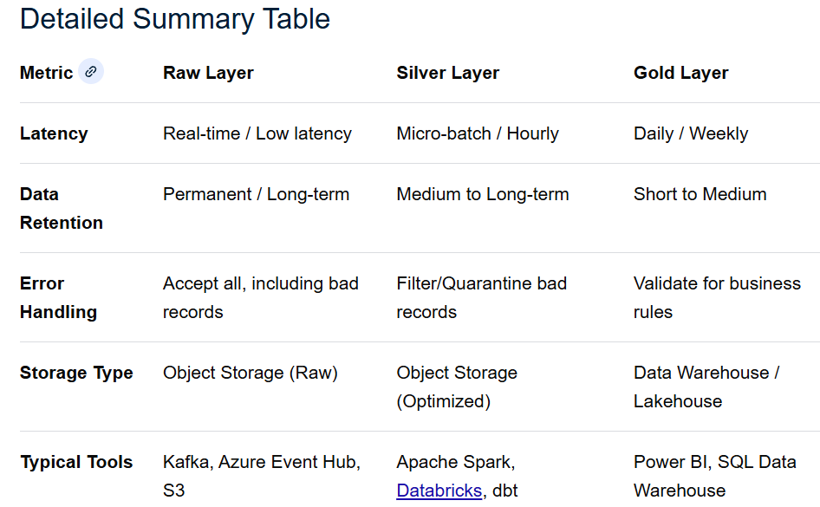
Medallion Architecture
3. Consumption Layer (Gold)
Characteristics:
Optimized for Read: Optimized for analytical tools (Tableau, Power BI, SQL Engines).
Data Modeling: Data is frequently transformed into star schemas or Kimball dimensional models.
Business Logic: Contains finalized, aggregated metrics, such as "Monthly Active Users" or "Daily Revenue".
Key Operations: Aggregation, joining dim/fact tables, complex business rules, row-level security.

Slide 38
Medallion Architecture
Key Takeaways for Data Engineering
The "Reprocessing" Safety Net: Because the Raw layer is preserved, you can always re-run the Raw -> Silver pipeline if a logic error is discovered in the Silver -> Gold transformation.
Schema Enforcement: Schema is generally enforced only when moving from Raw to Silver, not upon ingestion into Raw, allowing for flexible ingestion.
Performance vs. Flexibility: Raw provides high ingestion speed but poor query performance. Gold provides high query performance but lower flexibility.
For Further Exploration
What's Wrong with the Medallion Architecture? - YouTube
Implement Medallion Lakehouse Architecture in Fabric - Microsoft Fabric | Microsoft Learn
Building and Automating Hudi Medallion Architecture with AWS Glue Workflow Hands on Labs StepbyStep
Striking Gold: Mastering Medallion Architecture for Bronze, Silver, and Gold Tiers | by RK Iyer | Microsoft Azure | Medium
Practical Data Modeling: Medallion Architecture via Free Databricks Edition | by Nikhil Doye | Medium
A No-Nonsense Guide to Medallion Architecture | by Akshay Sharma | Medium

Slide 39
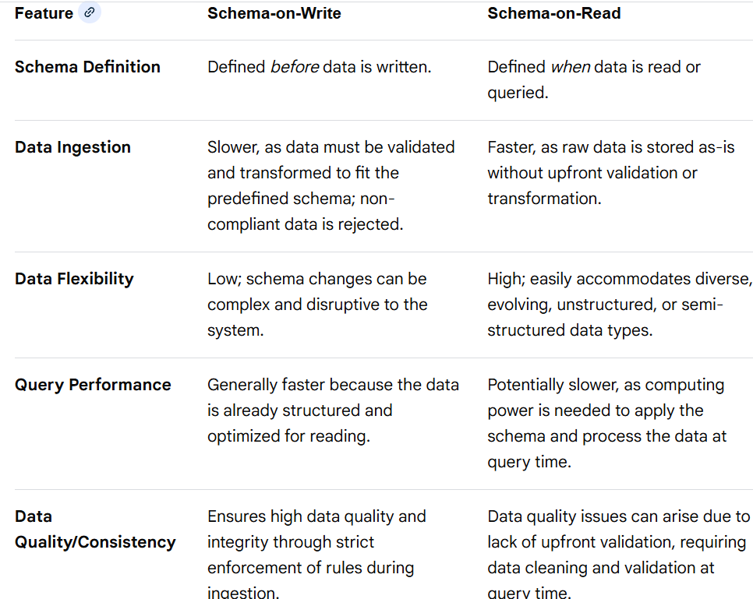
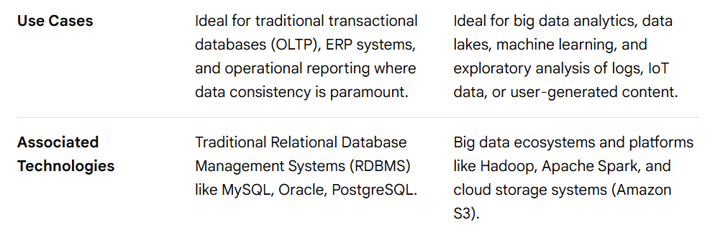
Schema-on-Write vs Schema-On-Read
The core difference between Schema-on-Write and Schema-on-Read lies in when the data is structured: before or after storage. Schema-on-Write prioritizes data consistency and fast querying, while Schema-on-Read offers flexibility and rapid data ingestion, especially for unstructured data
Many modern data architectures, such as the data lakehouse, use a hybrid approach, leveraging the flexibility of schema-on-read for raw data ingestion and the query efficiency of schema-on-write for structured, processed data. The best approach depends on specific business needs, data characteristics, and required performance.

Slide 40
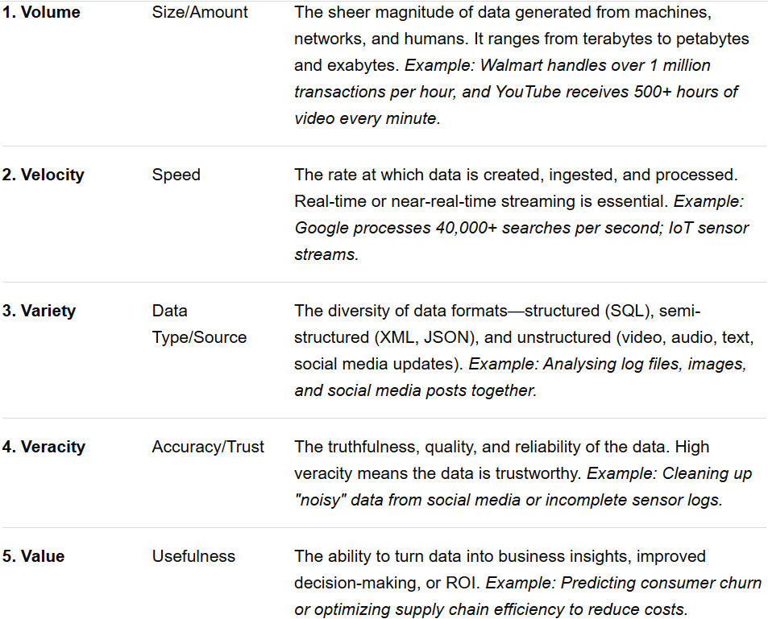
Vs of Big Data

Slide 41
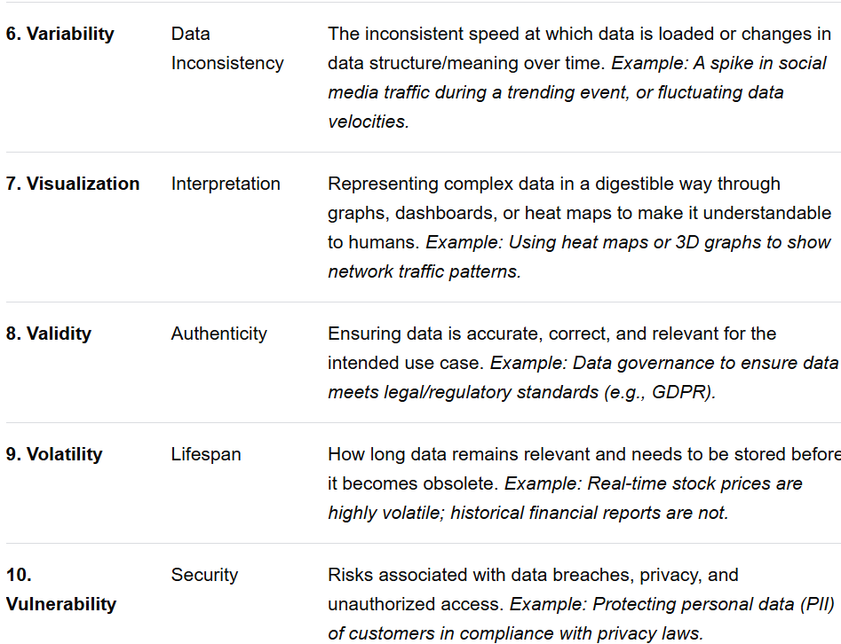
Vs of Big Data

Slide 42
Vs of Big Data
Breakdown of Key "Vs"
Volume & Velocity: These demand specialized, distributed, and scalable storage (e.g., Hadoop HDFS, Cloud Data Lakes) and real-time processing engines (e.g., Apache Spark) to handle high-growth data rates.
Variety & Variability: These require sophisticated data engineering and ETL (Extract, Transform, Load) pipelines to integrate diverse, messy data types (unstructured) and handle inconsistent, unpredictable data inputs.
Veracity, Validity, & Value: These are critical for data governance. High-quality (veracity) and correctly applied (validity) data is mandatory to achieve actionable insights (value).
Visualization & Vulnerability: These address the, "So what?" and, "Is it safe?" aspect of data, respectively—ensuring data is not only analyzed but also effectively communicated and secured.
Other Potential Vs (Emerging)
Viscosity: Measures the resistance to flow in the data, indicating how difficult it is to link, match, and transform data from different sources.
Virality: The speed at which data spreads, particularly common in social media analytics.
Venue: Defines the specific data source and its location (e.g., cloud, local server, specific application).
For Further Exploration –
Fifty-Six Big Data V’s Characteristics and Proposed Strategies to Overcome Security and Privacy

Slide 43
Distributed Data Pipeline Steps
🌍 Distributed Data Pipeline
Legend
DP = Data Plane
CP = Control Plane
RT = Real-time / Streaming
BT = Batch
1️⃣ Source & Signal Generation
Step Category Description Examples
Data Creation DP Raw data produced at origin IoT sensors, DB rows, logs
Change Capture DP Detect changes efficiently CDC, Debezium, SQL Log Reader
Event Emission DP Convert state → events Domain events, audit events
Timestamp Assignment DP Event-time vs processing-time Device clock vs ingestion clock
Metadata Enrichment DP Attach source metadata Source ID, region, schema version
Compression DP Reduce payload size Gzip, Snappy, LZ4
Encryption DP Secure data at rest/in flight TLS, envelope encryption
2️⃣ Ingestion Layer (Multi-Protocol)
Step Category Description Examples
Protocol Normalization DP Accept heterogeneous protocols HTTP, MQTT, AMQP, gRPC
API Gateway CP Rate limit, auth, routing Kong, Azure APIM
Buffering DP Absorb bursts Kafka, Event Hubs
Backpressure Handling DP Prevent overload Credits, windowed ACKs
Idempotent Writes DP Prevent duplicates Producer IDs, sequence numbers
Dead Letter Routing DP Isolate malformed messages DLQ topics
Multi-Tenant Isolation CP Prevent noisy neighbors Namespaces, quotas

Slide 44
Distributed Data Pipeline Steps
🌍 Distributed Data Pipeline
3️⃣ Transport & Messaging Fabric
Step Category Description Examples
Topic/Stream Partitioning DP Horizontal scalability Hash, range, key-based
Ordering Guarantees DP Maintain event order Per-partition ordering
Replication DP Fault tolerance ISR replicas
Retention Policy CP Time/size based retention 7 days, 1 TB
Exactly-Once Support DP No duplicates or loss EOS transactions
Schema Registry CP Enforce contract evolution Avro/Protobuf Registry
Cross-Region Replication CP DR & locality MirrorMaker, Geo-replication
4️⃣ Pre-Processing & Normalization
Step Category Description Examples
Deserialization DP Decode raw payload Avro/JSON/Protobuf
Schema Validation DP Contract enforcement Required fields
Canonical Modeling DP Unified internal model Domain canonical schema
Data Type Normalization DP Resolve mismatches UTC timestamps, decimals
Field Masking CP PII handling Tokenization, hashing
Null & Default Handling DP Safe processing Imputation rules
5️⃣ Stream Processing / ETL
Step Category Description Examples
Stateless Transformations DP Map, filter, project Field mapping
Stateful Operations DP Aggregations Count, sum, windows
Windowing DP Time-based grouping Tumbling, sliding
Watermarks DP Handle late data Event-time watermarks

Slide 45
Distributed Data Pipeline Steps
🌍 Distributed Data Pipeline
5️⃣ Stream Processing / ETL
Step Category Description Examples
Join Operations DP Cross-stream joins Stream–stream, stream–table
Deduplication DP Remove duplicates Event ID + TTL
Enrichment DP Add reference data Geo lookup, user profile
CEP (Pattern Detection) DP Detect sequences Fraud patterns
6️⃣ Quality, Validation & Trust
Step Category Description Examples
Data Quality Rules CP Accuracy & consistency Great Expectations
Anomaly Detection DP Spot abnormal patterns Volume spikes
Drift Detection DP Schema or data drift Feature distribution shifts
Referential Integrity DP Cross-entity checks Foreign key logic
Reprocessing Support CP Replay historical data Offset rewind
Quarantine Bad Data DP Prevent contamination Isolation topics
7️⃣ Storage (Polyglot Persistence)
Step Category Description Examples
Hot Storage DP Low-latency reads Redis, RocksDB
Warm Storage DP Analytical queries OLAP stores
Cold Storage DP Long-term archive Data Lake
Partitioning Strategy DP Query efficiency Time + key
Compaction DP Reduce storage Merge files
Versioning CP Historical traceability Iceberg, Delta
Encryption at Rest CP Compliance KMS keys

Slide 46
Distributed Data Pipeline Steps
🌍 Distributed Data Pipeline
8️⃣ Serving & Consumption
Step Category Description Examples
Query APIs DP Consumer access REST, GraphQL
Materialized Views DP Precomputed results Read models
Caching Layer DP Performance CDN, Redis
Streaming Feeds DP Downstream pipelines Fan-out topics
BI & Analytics DP Human insights Dashboards
ML Feature Feeds DP Model consumption Feature store
Access Control CP Fine-grained security RBAC, ABAC
9️⃣ Orchestration & Control Plane
Step Category Description Examples
Workflow Orchestration CP Step coordination Airflow, Temporal
Autoscaling CP Demand-based scaling KEDA
Configuration Management CP Central config Consul, App Config
Feature Flags CP Controlled rollout Canary releases
Deployment Strategies CP Zero-downtime Blue/Green
Schema Evolution CP Backward compatibility Compatibility rules
🔟 Observability & Operations
Step Category Description Examples
Metrics CP System health Lag, throughput
Distributed Tracing CP End-to-end visibility Trace IDs
Structured Logging CP Debuggability Correlated logs
SLA Monitoring CP Business guarantees Freshness SLAs

Slide 47
Distributed Data Pipeline Steps
🌍 Distributed Data Pipeline
🔟 Observability & Operations
Step Category Description Examples
Alerting CP Proactive response Lag alerts
Cost Monitoring CP FinOps Storage + compute
1️⃣1️⃣ Resilience, Recovery & Governance
Step Category Description Examples
Retry Strategies DP Transient failure handling Exponential backoff
Circuit Breakers DP Failure isolation Bulkheads
Disaster Recovery CP Regional failover Active-active
Lineage Tracking CP Auditability End-to-end lineage
Compliance Enforcement CP Regulatory adherence GDPR, SOC2
Data Deletion CP Right to be forgotten Tombstone events
🧠 One-Line Summary
Sources → Ingestion → Transport → Normalize → Process → Validate → Store → Serve → Observe → Govern

Slide 48
Distributed Data Pipeline Steps
For Further Exploration
Master Template for Building Data Architecture
Comprehensive Data Engineering Diagram
Fundamentals of Data Engineering
Data Engineering Design Patterns
Data-Engineering-with-Python
Rebuilding Reliable Data Pipelines Through Modern Tools
Data Pipelines Pocket Reference
97 Things Every Data Engineer Should Know
Introducing “Database Performance at Scale”: A Free, Open Source Book - ScyllaDB

Slide 49
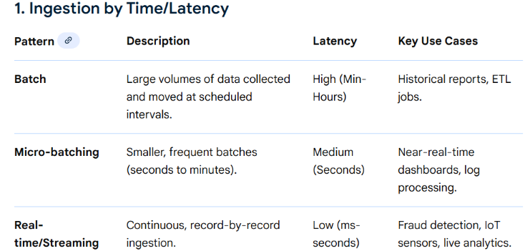
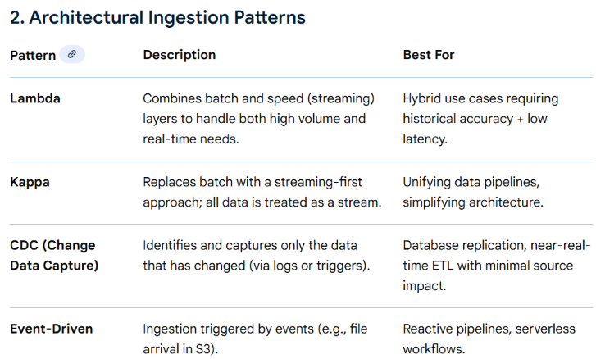
Distributed Ingestion Patterns
N.B. – Instead of Event Driven approach, Polling approach also can be considered which can inherently handle
backpressure since the consumer will poll the producer at it’s own rate.

Slide 50
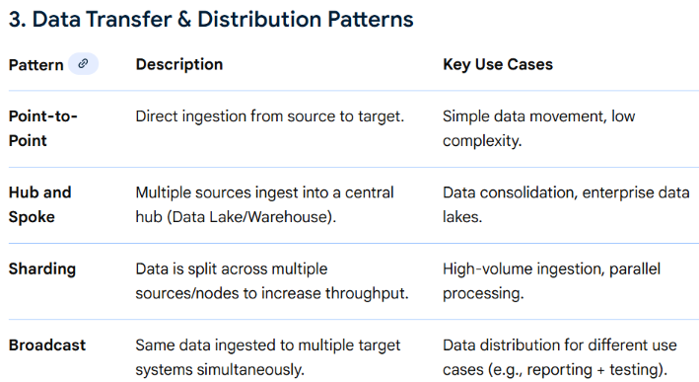
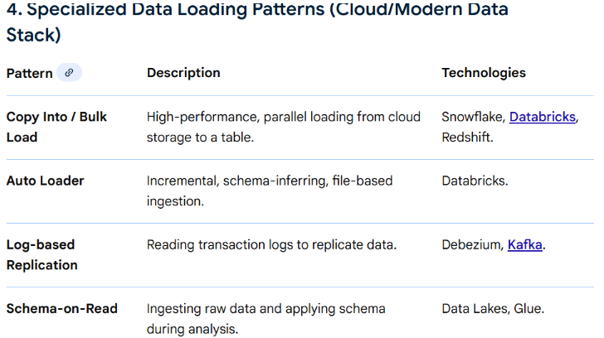
Distributed Ingestion Patterns

Slide 51
Distributed Ingestion Canonical Architecture
A very Common Canonical Architecture
External System
│
│ (HTTP GET - pull)[or can be some SFTP file drop or something similar as well]
▼
Ingestion Service / Poller
│
│ (Publish events)[Can have intermediate processing steps like normalization, processing, storage etc]
▼
Public Pub/Sub (Kafka / SNS / PubSub / Event Hub)
│
▼
Subscribers / Consumers
How It Works (Step-by-Step)
Ingestion service periodically calls the external GET API
Cron
Scheduled job
Event-triggered poll
It:
Parses response
Normalizes data
Deduplicates (important)
Converts responses → events
Publishes events to public Pub/Sub topic

Slide 52
Distributed Ingestion Canonical Architecture
A very Common Canonical Architecture
Key Design Challenges (Important ⚠️)
2. Polling Frequency vs Rate Limits
Strategies:
Adaptive polling
Backoff on 429
Delta endpoints (since=...)
Change Data Capture APIs (if available)
3. Event Semantics Mismatch
GET API Pub/Sub
Snapshot Event
Pull Push
State-based Change-based
You must decide event meaning:
EntityCreated
EntityUpdated
EntityDeleted
SnapshotRefreshed
When This Is a Good Idea ✅
✔ External system does not support webhooks
✔ Legacy systems
✔ Read-only integrations
✔ Low-frequency updates
✔ Eventually consistent systems

Slide 53
Distributed Ingestion Canonical Architecture
A very Common Canonical Architecture
When This Is a Bad Idea ❌
❌ High-frequency, low-latency requirements
❌ Strict ordering guarantees
❌ Real-time trading / payments
❌ APIs with no delta support
In such cases, prefer:
Webhooks
Streaming APIs
CDC
Message-based integration
Better Alternatives (If Available)
Alternative Why Better
Webhooks True push
Streaming APIs Continuous feed
CDC (Debezium) Exactly-once semantics
Event APIs Native event model

Slide 54
Distributed Ingestion Canonical Architecture
A very Common Canonical Architecture
A Full Enterprise Ingestion Platform Example
Sources
├── APIs
├── Files
├── CDC
├── Streams
↓
Unified Ingestion Layer
├── Validation
├── Schema Registry
├── Idempotency
↓
Raw Data Lake (Immutable)
↓
Curated Lake
↓
Serving Stores
├── OLTP
├── OLAP
├── Search

Slide 55
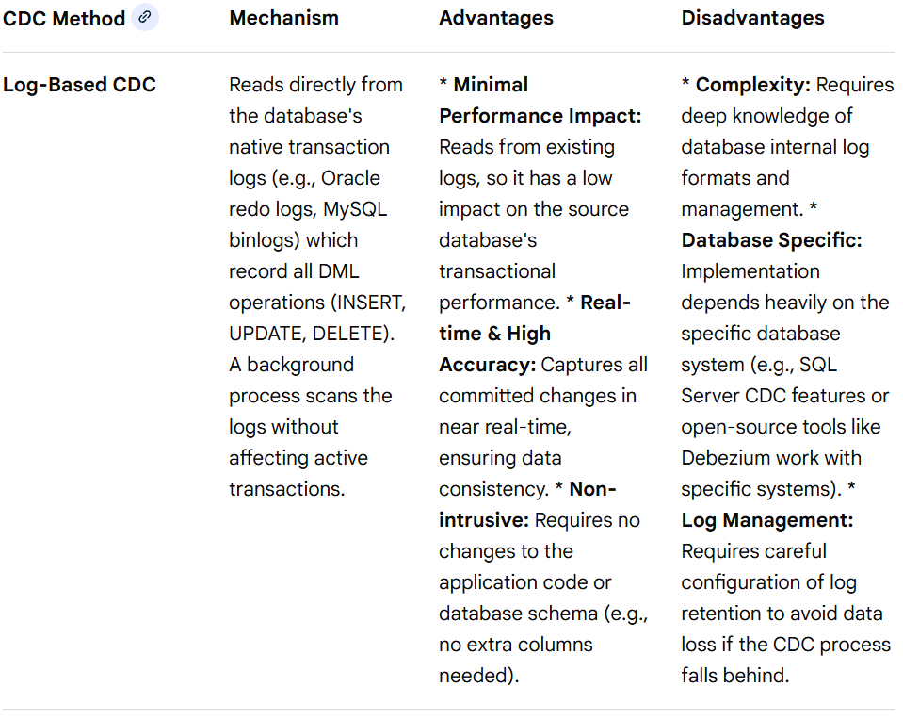
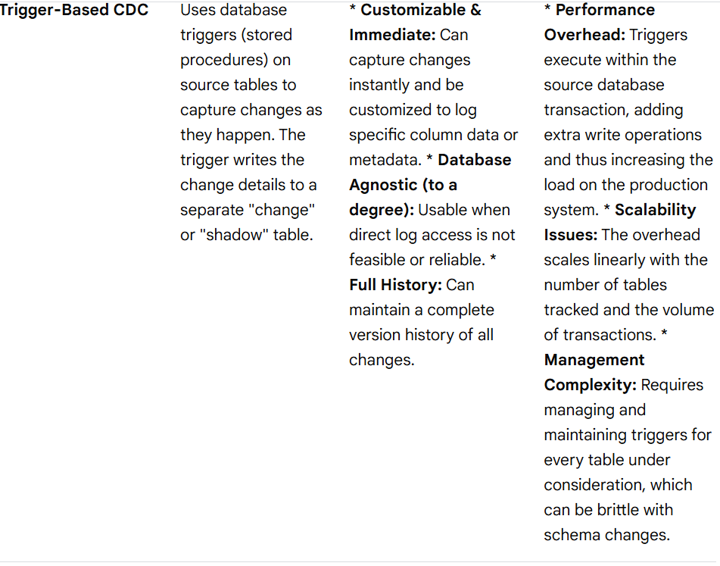
Distributed Ingestion Using CDC(Change Data Capture)
Change Data Capture (CDC) is a design pattern that identifies and captures changes in a source database and delivers those changes in real-time or near real-time to a target system. This is more efficient than full data reloads, as it only transfers incremental updates, minimizing overhead and ensuring data freshness.
CDC Methods

Slide 56
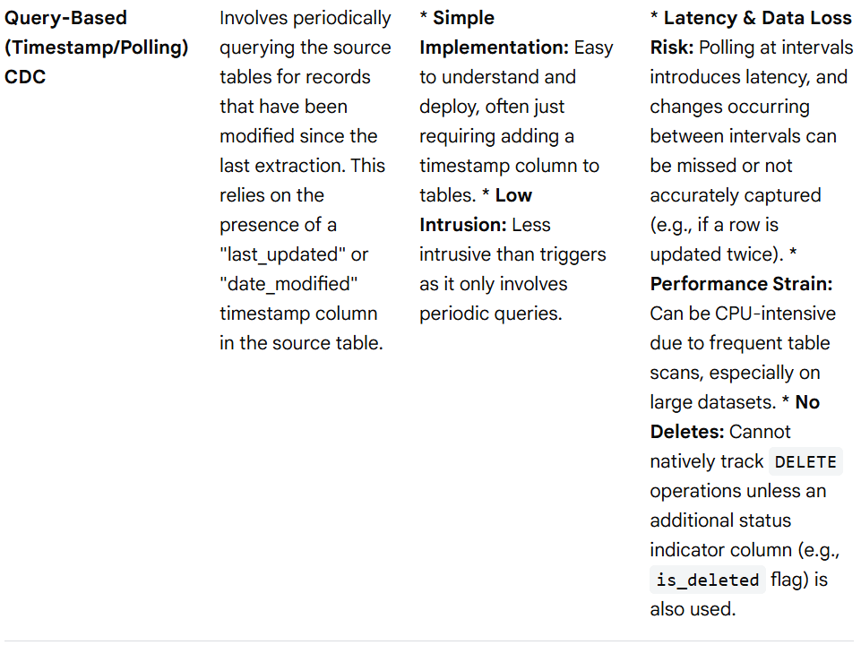
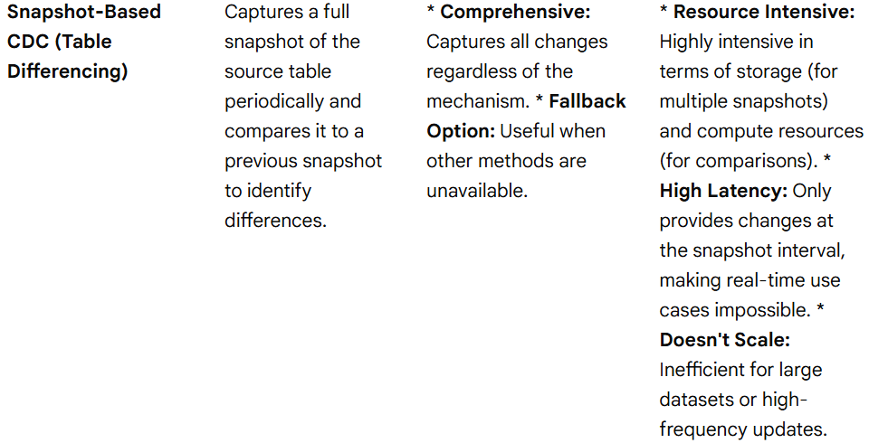
Distributed Ingestion Using CDC(Change Data Capture)
CDC Methods

Slide 57
Distributed Ingestion Using CDC(Change Data Capture)
Principles of Effective CDC
Minimal Impact: The CDC process should have the least possible performance impact on the source operational database.
Transactional Consistency: Changes should only be captured once a transaction is committed to ensure data integrity.
Idempotency: The system should handle potential duplicate events gracefully so that applying the same change multiple times does not lead to inconsistencies.
Schema Evolution: The CDC pipeline should be able to manage schema changes (e.g., adding a new column) without breaking the data flow.
Common Use Cases
Real-time Analytics: Powering operational dashboards and analytics platforms with the freshest data.
Data Warehousing: Efficiently loading incremental data into data warehouses without large batch jobs.
Microservices Data Exchange: Synchronizing data reliably across different microservices in an event-driven architecture.
Caching & Indexing: Invalidating caches or updating search indexes (e.g., Elasticsearch) as source data changes.
For Further Exploration
CDC (change data capture)—Approaches, architectures, and best practices
Change Data Capture 101: The complete guide
Streaming Change Data Capture: A Foundation for Modern Data Architectures | TDWI
Data Mesh Patterns: Change Data Capture | by Eric Broda | TDS Archive | Medium
Mastering Change Data Capture: A Hands-On Guide to Real-Time, Zero-Latency Synchronization Between Postgres, MySQL, and Kafka
Evaluating Change Data Capture Tools: A Comprehensive Guide

Slide 58
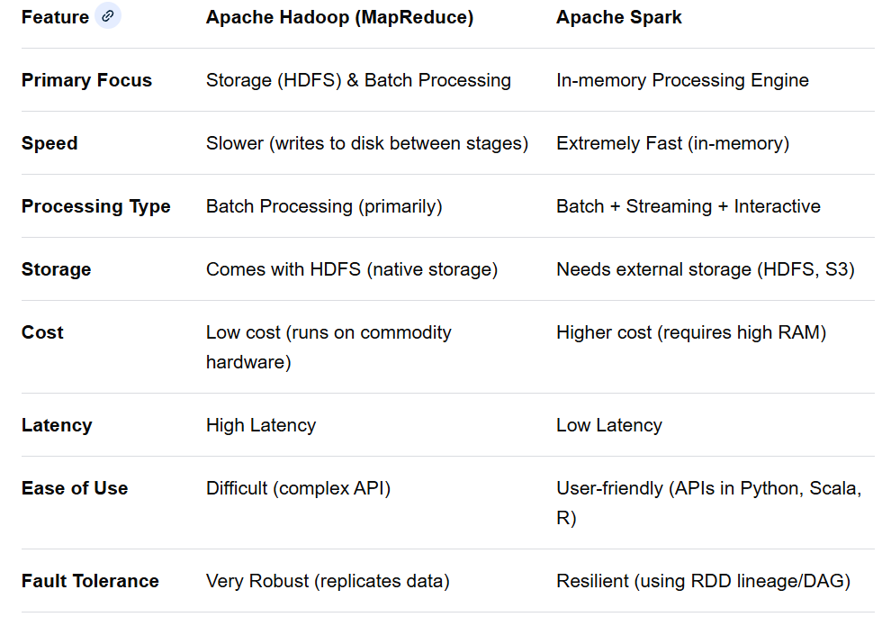
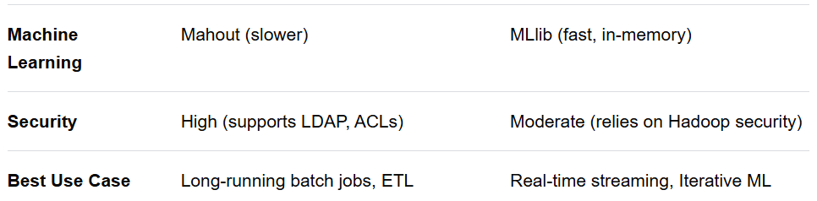
Distributed Batch Processing(using Apache Spark)
Hadoop vs Apache Spark : Key Differences

Slide 59
Distributed Batch Processing(using Apache Spark)
Hadoop vs Apache Spark : Key Differences
Breakdown
Performance: Spark is significantly faster than MapReduce because it keeps data in memory between operations rather than writing intermediate results to disk.
Architecture: Hadoop includes both storage (HDFS) and processing (MapReduce), whereas Spark is purely a processing engine that must rely on a file system like HDFS or Amazon S3.
Usability: Spark provides a more developer-friendly experience with high-level APIs in Python, Scala, and R, whereas Hadoop MapReduce requires complex Java coding.
Security: Hadoop has more established security mechanisms (ACLs, Kerberos), while Spark often relies on integrating with Hadoop to achieve the same level.
When to Choose Which?
Choose Hadoop: When you have petabytes of data, budget constraints, need high reliability for long-running batch jobs, and real-time processing is not required.
Choose Spark: When you need real-time data streaming (e.g., streaming analytics), iterative machine learning algorithms, or fast, interactive ad-hoc queries

Slide 60
Distributed Batch Processing(using Apache Spark)
Apache Spark Architecture
+----------------------+
| User Program |
| (Spark Application) |
+----------+-----------+
|
v
+----------------------+
| Driver |
|----------------------|
| SparkSession |
| DAG Scheduler |
| Task Scheduler |
+----------+-----------+
|
| Requests Resources
v
+----------------------------------+
| Cluster Manager |
| (Standalone / YARN / K8s etc.) |
+----------+-----------+------------+
| |
Allocates | | Allocates
Executors | | Executors
v v

Slide 61
Distributed Batch Processing(using Apache Spark)
Apache Spark Architecture
+--------------------+ +--------------------+
| Worker Node 1 | | Worker Node 2 |
|--------------------| |--------------------|
| Executor 1 | | Executor 3 |
| - Task A | | - Task C |
| - Task B | | - Task D |
| - Cache Data | | - Cache Data |
|--------------------| |--------------------|
| Executor 2 | | Executor 4 |
| - Task E | | - Task F |
+--------------------+ +--------------------+
Apache Spark follows a master–worker style distributed architecture designed for fast, in-memory, large-scale data processing.
🏗️ High-Level Components
1️⃣ Driver Program (Master Brain)
This is where your Spark application starts.
Responsibilities:
Runs your main() function
Creates the SparkSession / SparkContext
Builds the DAG (Directed Acyclic Graph) of operations
Splits jobs → stages → tasks
Sends tasks to executors
Collects results
👉 Think of it as the project manager.

Slide 62
Distributed Batch Processing(using Apache Spark)
Apache Spark Architecture
🏗️ High-Level Components
2️⃣ Cluster Manager (Resource Boss)
Allocates resources (CPU / memory) across the cluster.
Spark can run on different cluster managers:
Standalone (Spark’s built-in)
YARN
Mesos
Kubernetes
Role:
Launches executors
Manages worker nodes
Assigns resources to applications
👉 Think of it as HR + Infrastructure.
3️⃣ Worker Nodes
Physical or virtual machines that actually do the computation.
Each worker hosts one or more Executors.
4️⃣ Executors (Real Workers)
Executors are JVM processes running on worker nodes.
They:
Execute tasks
Cache data in memory
Return results to Driver
Each Spark application has its own executors.
👉 Think of executors as employees doing the real work.

Slide 63
Distributed Batch Processing(using Apache Spark)
Apache Spark Architecture
🏗️ High-Level Components
5️⃣ Tasks
Smallest unit of work.
One task per data partition
Executed inside executors
Created by Driver
🔄 Execution Flow (Very Important)
Here’s what happens when you run Spark code:
You submit Spark job
Driver starts
Driver asks Cluster Manager for resources
Cluster Manager launches Executors
Driver creates DAG
DAG → Stages → Tasks
Tasks sent to Executors
Executors process data
Results sent back to Driver
🧠 Internal Spark Architecture Layers
✔️ Spark Core
Task scheduling
Memory management
Fault tolerance
I/O

Slide 64
Distributed Batch Processing(using Apache Spark)
Apache Spark Architecture
🧠 Internal Spark Architecture Layers
✔️ Spark Core
Task scheduling
Memory management
Fault tolerance
I/O
✔️ Higher-Level Libraries (built on Core)
Spark SQL
DataFrame / Dataset API
MLlib (Machine Learning)
GraphX
Structured Streaming
All of these ultimately rely on Spark Core.
⚡ Why Spark Is Fast
In-memory computation
DAG execution (no unnecessary disk writes)
Lazy evaluation
Parallel processing
Efficient fault recovery via lineage

Slide 65
Distributed Batch Processing(using Apache Spark)
Apache Spark Architecture
🧩 Simple Analogy
Imagine a company:
Spark Real World
Driver Project Manager
Cluster Manager HR
Worker Nodes Office Buildings
Executors Employees
🔄 Job Execution Flow (Text Representation)
User Code
↓
Driver Creates Logical Plan
↓
DAG (Directed Acyclic Graph)
↓
Stages (Split by Shuffle Boundaries)
↓
Tasks (One per Partition)
↓
Executors Execute Tasks in Parallel
↓
Results Sent Back to Driver

Slide 66
Distributed Batch Processing(using Apache Spark)
Apache Spark Architecture
🧠 Internal Logical Flow Diagram
Transformations (Lazy)
|
v
Logical Plan
|
v
DAG Scheduler
|
v
Stage Division
|
v
Task Scheduler
|
v
Executors Execute Tasks
🏗 Memory View (Inside Executor)
+----------------------------------+
| Executor JVM |
|----------------------------------|
| Execution Memory (Shuffles) |
| Storage Memory (Cache/Persist) |
| User Code |
| Task Threads |
+----------------------------------+

Slide 67
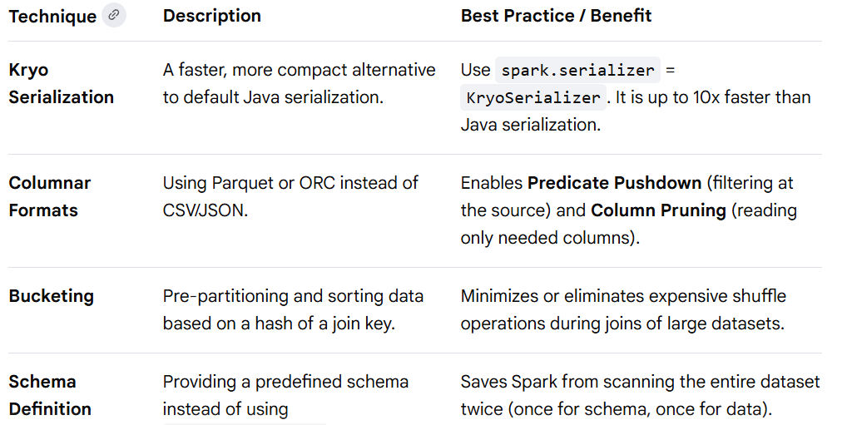
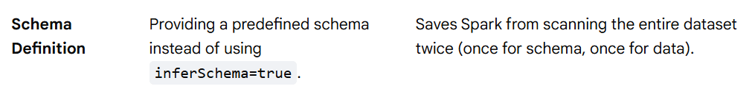
Distributed Batch Processing(using Apache Spark)
Apache Spark Performance Optimization and Tuning
Data Serialization and Storage

Slide 68
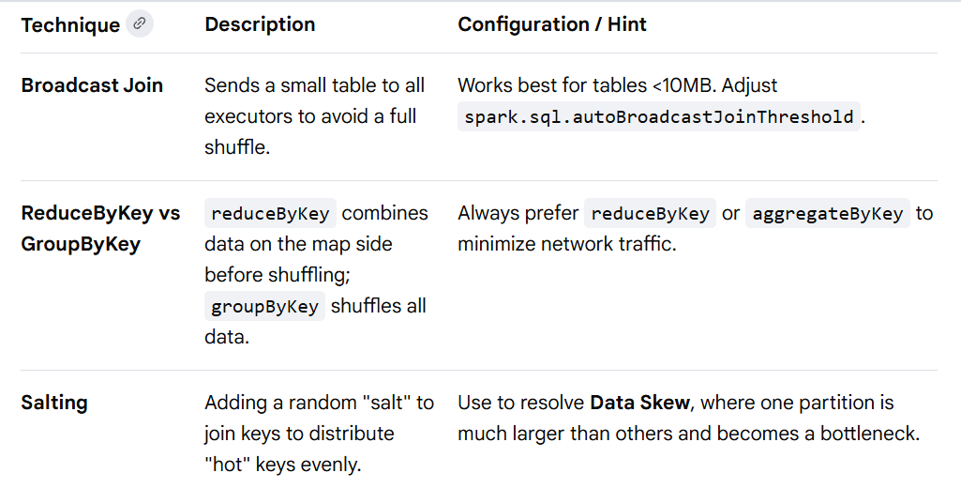
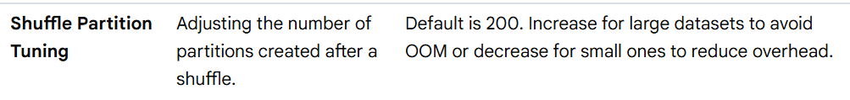
Distributed Batch Processing(using Apache Spark)
Apache Spark Performance Optimization and Tuning
Join & Shuffle Optimization

Slide 69
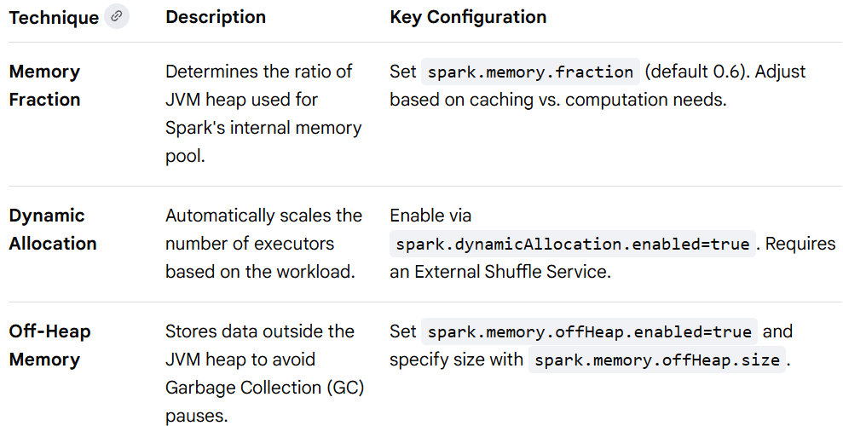
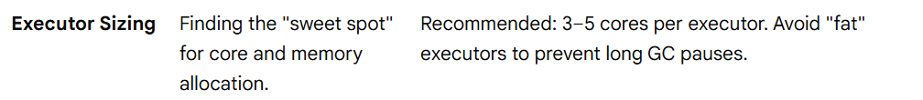
Distributed Batch Processing(using Apache Spark)
Apache Spark Performance Optimization and Tuning
Memory & Resource Management

Slide 70
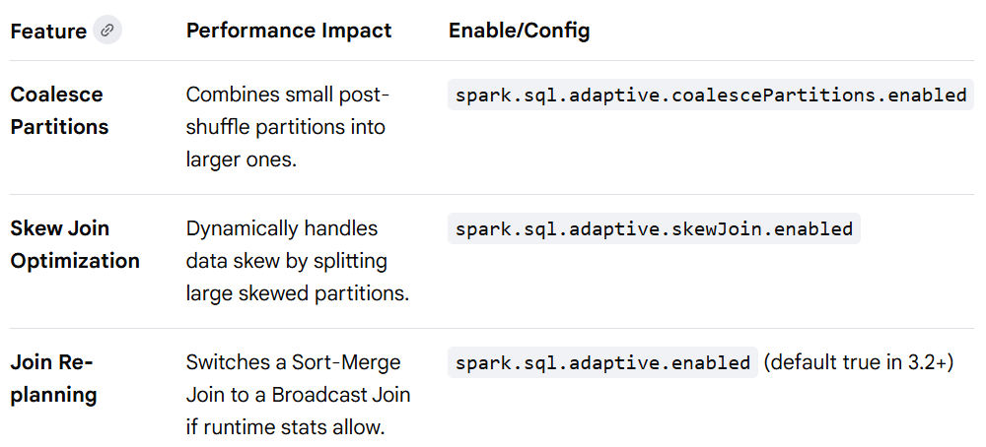
Distributed Batch Processing(using Apache Spark)
Apache Spark Performance Optimization and Tuning
AQE(Adaptive Query Execution)

Slide 71
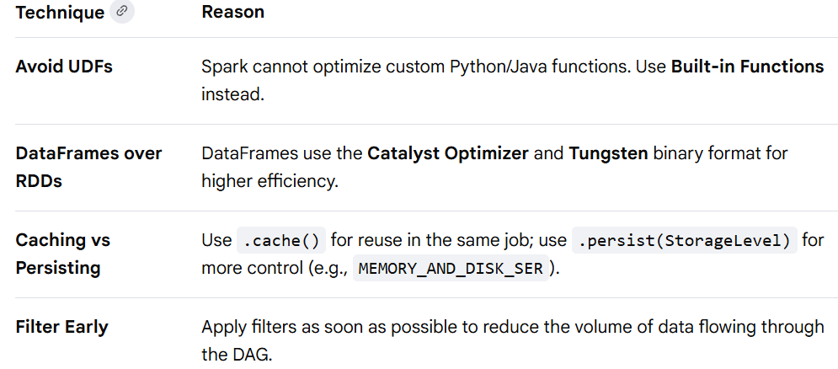
Distributed Batch Processing(using Apache Spark)
Apache Spark Performance Optimization and Tuning
Code Level Best Practices

Slide 72
Distributed Batch Processing(using Apache Spark)
For Further Exploration
The Hadoop Ecosystem Table
Hadoop – Apache Hadoop 3.4.1
Hadoop Internals
LearningSparkV2
Spark-The-Definitive-Guide
Why PySpark| LinkedIn
Mastering-Apache-Spark-2x
Data-Algorithms-with-Spark
Overview - Spark 3.5.3 Documentation
Spark Core - The Internals of Spark Core
Spark Internals
Resilient Distributed Dataset (RDD) - The Internals of Spark Core (Resiliency & better read throughput is achieved via in-memory Replication across servers while better write throughput is achieved via partitioning)
Big Data File Formats
Some aspects of parallel and distributed iterative algorithms—A survey – ScienceDirect
Bigdata-on-Kubernetes
Challenges (BD2)
At most once, at least once, exactly once - by Alex Xu
Data Processing Architecture On Microsoft Azure | by Karunakar Kotha | Medium

Slide 73
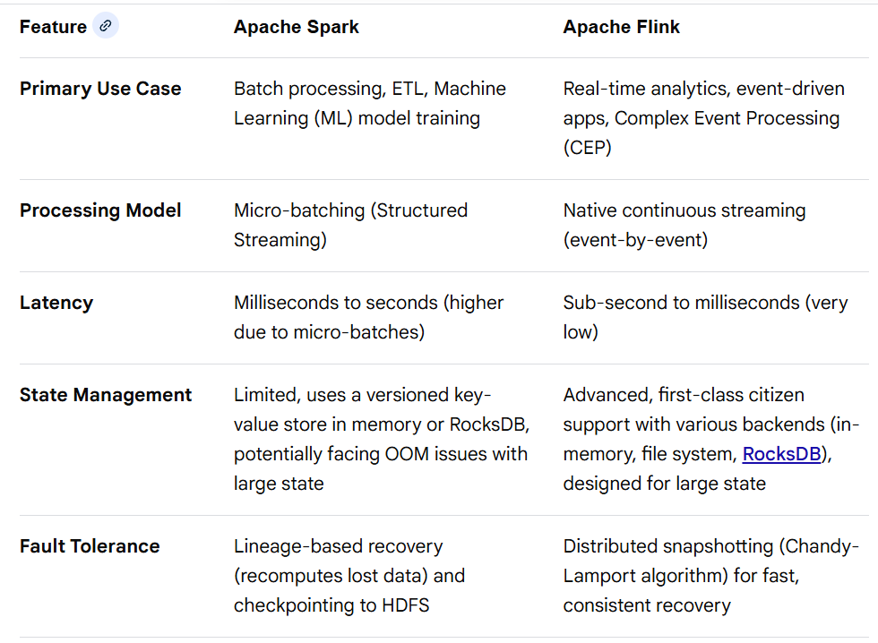
Distributed Stream Processing(using Apache Flink)
Apache Spark vs Apache Flink: Key Differences
Apache Flink and Apache Spark are both powerful, open-source data processing frameworks designed for large-scale operations, but they differ fundamentally in their core processing models. Flink is a true stream processor designed for low-latency, real-time event-by-event processing, while Spark is primarily a batch processing engine that uses micro-batches to emulate streaming

Slide 74
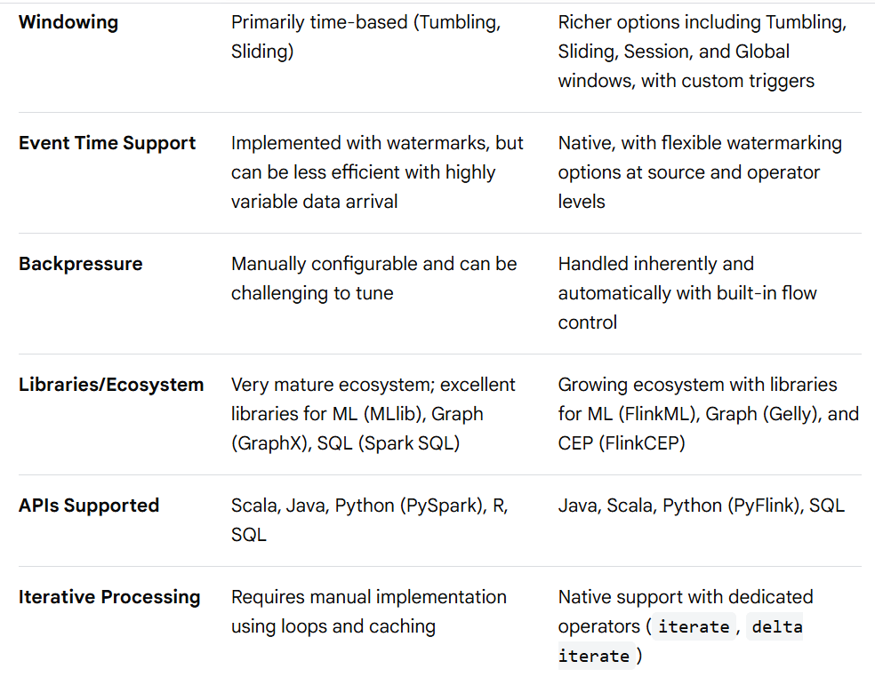
Distributed Stream Processing(using Apache Flink)
Apache Spark vs Apache Flink: Key Differences

Slide 75
Distributed Stream Processing(using Apache Flink)
Apache Spark vs Apache Flink: Key Differences
Key Takeaways
Choose Apache Flink if your application requires true real-time, event-by-event processing with minimal latency (milliseconds), sophisticated state management, and complex event processing capabilities (e.g., fraud detection, real-time recommendations).
Choose Apache Spark if your primary workloads involve large-scale, high-throughput batch processing, ETL jobs, or extensive machine learning model training, and if your team is already invested in its mature and extensive ecosystem.

Slide 76
Distributed Stream Processing(using Apache Flink)
1️⃣ High-Level Logical Architecture
USER / CLIENT
|
v
+---------------------+
| Flink Client |
| (CLI / REST / API) |
+---------------------+
|
Submit JobGraph
|
v
=================================================
| FLINK CLUSTER |
| |
| +-------------------------------+ |
| | JobManager(s) | |
| | (Master / Dispatcher) | |
| | | |
| | - Job Submission | |
| | - Scheduling | |
| | - Checkpoint Coordination | |
| | - Failure Recovery | |
| +---------------+---------------+ |
| | |

Slide 77
Distributed Stream Processing(using Apache Flink)
1️⃣ High-Level Logical Architecture
| Task Deployment |
| | |
| --------------------------------------- |
| | | | | |
| v v v v |
|+-------+ +-------+ +-------+ +-------+
||TaskMgr| |TaskMgr| |TaskMgr| |TaskMgr|
|+-------+ +-------+ +-------+ +-------+
| | | | |
| | Slots | Slots | Slots |
| v v v v
| [Subtasks] [Subtasks] [Subtasks] [Subtasks]
|
=================================================
Core Components Explained
🔹 Flink Client
Builds the JobGraph
Uploads job JARs
Submits jobs
Can exit after submission (cluster keeps running)

Slide 78
Distributed Stream Processing(using Apache Flink)
Core Components Explained
🔹 JobManager (Master Node)
Internally consists of:
+--------------------------------------+
| Dispatcher |
| - Accepts job submissions |
+--------------------------------------+
| ResourceManager |
| - Allocates TaskManagers |
| - Talks to YARN/K8s/Standalone |
+--------------------------------------+
| JobMaster (per job) |
| - Builds ExecutionGraph |
| - Schedules tasks |
| - Coordinates checkpoints |
| - Handles failures |
+--------------------------------------+
Responsibilities:
✅ Converts JobGraph → ExecutionGraph
✅ Assigns tasks to slots
✅ Triggers checkpoints
✅ Restarts failed tasks

Slide 79
Distributed Stream Processing(using Apache Flink)
Core Components Explained
🔹 TaskManager (Worker Nodes)
Each TaskManager contains:
TaskManager
|
+-- Slot 1 → Subtask
+-- Slot 2 → Subtask
+-- Slot 3 → Subtask
They:
Execute operators
Exchange data over network
Maintain local state
Send heartbeats to JobManager
3️⃣ Slot & Parallelism Model
1 TaskManager (4 Slots)
+--------------------------------+
| Slot1 | Slot2 | Slot3 | Slot4 |
+--------------------------------+
Each slot can run ONE parallel subtask.
Total Parallelism:
Parallelism = TaskManagers × Slots
4️⃣ Dataflow / Operator Pipeline
Example:
Source → Map → KeyBy → Window → Reduce → Sink

Slide 80
Distributed Stream Processing(using Apache Flink)
Core Components Explained
4️⃣ Dataflow / Operator Pipeline
Internally becomes:
Source Subtasks
|
v
Shuffle / Network Exchange
|
v
Window Subtasks
|
v
Sink Subtasks
Key points:
Operators are chained for performance
Network shuffles occur at keyBy, rebalance, etc.
5️⃣ Execution Graph Layers
User Code
|
v
StreamGraph (logical pipeline)
|
v
JobGraph (physical operators)
|
v
ExecutionGraph (runtime scheduling)

Slide 81
Distributed Stream Processing(using Apache Flink)
Core Components Explained
6️⃣ State Management Architecture
Operator
|
v
State Backend
|
+--> Heap State (JVM)
|
+--> RocksDB (disk-based)
Types of state:
Keyed State
Operator State
Broadcast State
7️⃣ Checkpointing & Fault Tolerance (Exactly Once)
JobManager
|
Trigger Checkpoint Barrier
|
v
Source → Operator → Operator → Sink
| | |
Save State Save State Save State
|
v
Remote Storage (S3 / HDFS / GCS)

Slide 82
Distributed Stream Processing(using Apache Flink)
Core Components Explained
7️⃣ Checkpointing & Fault Tolerance (Exactly Once)
On failure:
Failure detected
|
JobManager Restarts Tasks
|
Restore State from Checkpoint
|
Continue Processing
Guarantees:
✅ Exactly-once
✅ At-least-once (configurable)
8️⃣ Deployment Architectures
Standalone
User → JobManager → TaskManagers
YARN / Kubernetes
User
|
v
Resource Manager (YARN/K8s)
|
v
JobManager Pod
|
v
TaskManager Pods

Slide 83
Distributed Stream Processing(using Apache Flink)
Core Components Explained
9️⃣ Memory Model (Simplified)
TaskManager Memory
|
+-- Framework Heap
+-- Task Heap
+-- Managed Memory
+-- Network Buffers
+-- RocksDB Native Memory
🔁 Complete Runtime Flow (End to End)
1. User submits job
2. Client builds JobGraph
3. JobManager creates ExecutionGraph
4. ResourceManager allocates TaskManagers
5. Tasks deployed to slots
6. Data starts flowing
7. Checkpoints triggered periodically
8. Failures → automatic recovery
9. Results written to Sink
✅ Key Architectural Strengths
True streaming (not micro-batch)
Event-time processing
Exactly-once state consistency
Massive horizontal scalability
Backpressure aware
Fine-grained recovery (task-level, not job-level)

Slide 84
Distributed Stream Processing(using Apache Flink)
Complex Events Processing
Complex Event Processing (CEP) is a technology for tracking and analyzing, in real-time, streams of data from multiple sources(maybe with multiple schemas) to identify meaningful patterns, relationships, or complex events (e.g., fraud, system failures). It enables immediate, proactive actions by processing data continuously as it arrives, rather than waiting to store it.
Why and When We Need CEP
Real-time Decision Making: Necessary when delays cause significant losses or risks, such as in algorithmic trading (stock price shifts).
Pattern Recognition & Correlation: Needed to identify a sequence of events, like detecting a credit card transaction followed by a suspicious login (security/fraud detection).
IoT and Sensor Data Monitoring: Essential for analyzing thousands of data points from industrial facilities to predict malfunctions before they occur.
Complex Scenario Detection: Used to infer high-level situations, such as identifying a "wedding" from separate events like church bells, rice throwing, and a couple in special attire.
Business Activity Monitoring (BAM): Used for tracking logistics, supply chains, or customer interactions to detect bottlenecks or opportunities.
Key Characteristics
High Volume & Speed: Handles massive streams of data.
Low Latency: Processes and alerts in near real-time.
Temporal Correlations: Understands the time relationship between events.
Common use cases include fraud detection in banking, IoT sensor monitoring in manufacturing, algorithmic trading, and autonomous vehicle decision-making.

Slide 85
Distributed Stream Processing(using Apache Flink)
🧠 Apache Flink CEP
Think of CEP as:
A stateful NFA (Non-Deterministic Finite Automaton) running per key over ordered event streams.
Every key maintains:
partial matches
timers
state
branches (due to non-determinism)
This is critical for understanding memory growth and performance.
1. Core CEP Building Blocks
1️⃣ Event Stream
CEP always works on:
Keyed DataStream<T>
Why?
Because CEP maintains independent pattern machines per key.
If you skip keyBy():
❌ One giant global NFA
❌ Massive state
❌ Poor scalability

Slide 86
Distributed Stream Processing(using Apache Flink)
🧠 Apache Flink CEP
1. Core CEP Building Blocks
2️⃣ Pattern
A pattern is a sequence graph, not just a list.
Example:
Pattern.begin("A")
.where(...)
.next("B")
.where(...)
.within(Time.minutes(5));
Internally becomes:
A --> B
Each node stores:
predicate
quantifier
consuming strategy
window constraint
3️⃣ PatternStream
After applying pattern:
CEP.pattern(stream, pattern)
you get:
PatternStream<T>
Which you resolve via:
select()
flatSelect()
process()

Slide 87
Distributed Stream Processing(using Apache Flink)
🧠 Apache Flink CEP
2. Pattern Operators (VERY IMPORTANT)
These define how events are consumed.
▶ next() — STRICT contiguity
A immediately followed by B
No unrelated events allowed in between.
If anything appears between A and B → match discarded.
Use when order must be exact.
▶ followedBy() — RELAXED contiguity
A ... anything ... B
Intermediate events allowed.
Most common.
▶ followedByAny() — NON-DETERMINISTIC
Creates branching paths.
Example:
A
\→ B1
\→ B2
Explodes state if stream is dense.
⚠️ Use sparingly.

Slide 88
Distributed Stream Processing(using Apache Flink)
🧠 Apache Flink CEP
3. Quantifiers (Repetition Semantics)
oneOrMore()
A+
times(n)
A{n}
times(m,n)
A{m,n}
greedy()
Consumes maximum possible events.
optional()
Makes pattern nullable.
allowCombinations()
Creates all permutations.
⚠️ This is combinatorial explosion territory.
4. Conditions
SimpleCondition
Single event filtering.
IterativeCondition
Can access previously matched events:
ctx.getEventsForPattern("A")
Used for:
cumulative thresholds
relational logic
⚠️ Expensive — each evaluation scans partial state.

Slide 89
Distributed Stream Processing(using Apache Flink)
🧠 Apache Flink CEP
5. Time Semantics
CEP is highly sensitive to time configuration.
Event Time (recommended)
Uses timestamps + watermarks.
Patterns respect logical event order.
Processing Time
Uses machine clock.
Fast but unsafe for disorder.
Ingestion Time (rarely used)
Hybrid.
within()
Defines pattern window:
.within(Time.minutes(10))
Meaning:
From FIRST matched event to LAST.
Not per step.
Timer Behavior
CEP registers timers internally:
Pattern start time + within()
When fires:
→ partial matches discarded

Slide 90
Distributed Stream Processing(using Apache Flink)
🧠 Apache Flink CEP
6. AfterMatchSkipStrategy (CRITICAL)
Controls overlapping matches.
noSkip() (default)
Returns ALL matches.
Produces duplicates.
skipPastLastEvent()
Consumes whole match.
Most practical for alerts.
skipToNext()
Moves one event forward.
skipToFirst("A")
Custom skip anchor.
Example impact:
Events: A A B
Pattern: A followedBy B
noSkip:
[A1,B], [A2,B]
skipPastLast:
[A2,B]

Slide 91
Distributed Stream Processing(using Apache Flink)
🧠 Apache Flink CEP
7. Internal Engine (Advanced)
CEP runs:
Per key:
NFA Instance
|
+-- Active States
+-- Partial Matches
+-- Timers
Each incoming event:
Evaluated against ALL active states
Creates new branches
Old branches expire via timers
This explains why CEP can become memory-heavy.
8. State Backend Interaction
CEP stores:
partial matches
counters
timestamps
Inside:
Keyed State Backend
Usually:
Heap (small jobs)
RocksDB (large CEP)

Slide 92
Distributed Stream Processing(using Apache Flink)
🧠 Apache Flink CEP
8. State Backend Interaction
Rule:
If pattern window is large → MUST use RocksDB.
Heap will OOM.
9. Late Events Handling
CEP respects watermarks.
Late events:
ignored
or routed via side output (if configured)
But:
CEP does NOT re-open closed patterns.
Once watermark passes window → done.
10. Output Modes
select()
Single match → single output.
flatSelect()
Single match → multiple outputs.
process()
Low-level access with context + timestamps.
Use for advanced logic.

Slide 93
Distributed Stream Processing(using Apache Flink)
🧠 Apache Flink CEP
11. Typical CEP Patterns
Sequence
Login → Failed → Failed → Locked
Absence
Use NOT pattern:
A followedBy NOT B within 5 min
Threshold
Using IterativeCondition.
Rate limiting
times(n).within()
Fraud chains
Multi-stage patterns.
12. Production Gotchas (REAL WORLD)
⚠️ 1. Missing keyBy()
Creates global NFA.
Instant disaster.
⚠️ 2. Using followedByAny blindly
State explosion.
⚠️ 3. Large within()
Means long-lived state.
Memory grows linearly with input.
⚠️ 4. IterativeCondition abuse
Each evaluation loops previous matches.
CPU killer.

Slide 94
Distributed Stream Processing(using Apache Flink)
🧠 Apache Flink CEP
12. Production Gotchas (REAL WORLD)
⚠️ 5. No AfterMatchSkipStrategy
Duplicate alerts everywhere.
⚠️ 6. Forgetting watermarks
Patterns never complete.
⚠️ 7. Optional + looping quantifiers
Creates infinite paths.
13. Performance Techniques
✅ Always keyBy
✅ Use skipPastLastEvent
✅ Limit followedByAny
✅ Prefer SimpleCondition
✅ Keep within tight
✅ Use RocksDB for large windows
✅ Avoid allowCombinations
✅ Filter early BEFORE CEP
14. Debugging CEP
Enable:
execution.checkpointing.debug
Also:
inspect state size
log matched paths
test patterns with small streams

Slide 95
Distributed Stream Processing(using Apache Flink)
🧠 Apache Flink CEP
15. Design Rules of Thumb
Think in automata, not SQL.
CEP is NOT a join engine.
CEP is NOT batch analytics.
CEP excels at:
sequences
temporal correlations
behavioral detection
16. CEP vs SQL
CEP:
✔ Ordered
✔ Stateful
✔ Temporal
SQL:
✔ Relational
✔ Set-based
Use CEP only for temporal logic.
🧩 Summary Mental Model
Keyed Stream -- > Per-key NFA → Partial Matches --> Timers + State → Select / Alert

Slide 96
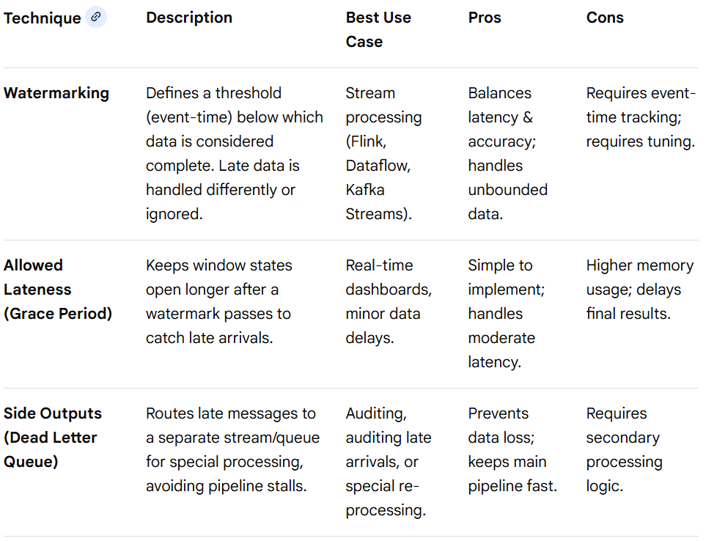
Distributed Stream Processing(using Apache Flink)
Late Arriving Data Handling Techniques
Late-arriving messages (data that arrives after its scheduled processing window or out-of-order) are a common issue in distributed, high-throughput systems like Apache Kafka, RabbitMQ, and streaming frameworks (Flink, Spark). Techniques to manage this involve a tradeoff between data completeness (accuracy) and latency (speed).

Slide 97
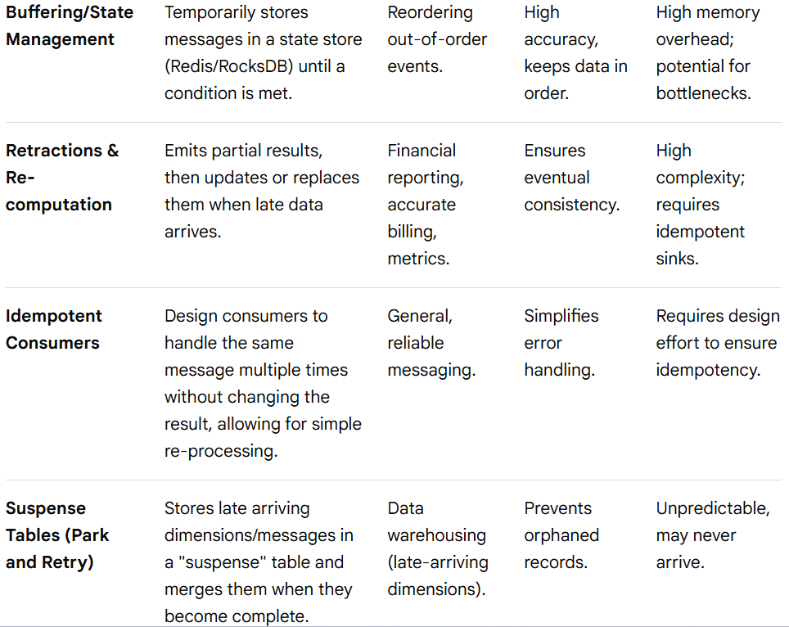
Distributed Stream Processing(using Apache Flink)
Late Arriving Data Handling Techniques

Slide 98
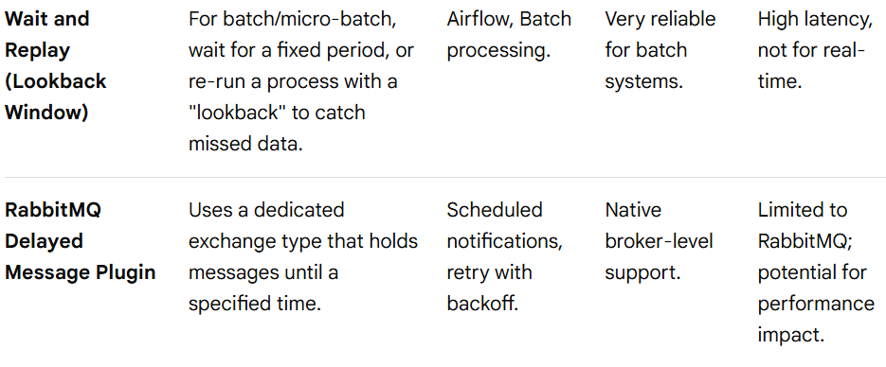
Distributed Stream Processing(using Apache Flink)
Late Arriving Data Handling Techniques
Breakdown of Techniques
1. Stream Processing Techniques (Event-Time)
Watermarking: A watermark is a metadata timestamp that tells the system: "I believe all events with event time older than this watermark have arrived". If a message arrives after its watermark has passed, it is considered "late".
Heuristic Watermarks: Use a 10-second buffer to handle typical network lag.
Adaptive Watermarks: Monitor recent latency and adjust the watermark delay automatically.
Allowed Lateness: Allows you to define a "grace period" (e.g., 10 minutes) for a window. Data arriving within this period triggers an update to the already produced result.
2. Message Broker & Consumer Techniques (Order & Retry)
Ordered Queues (Partitioning): Kafka guarantees order only within a partition. By using a consistent key (e.g., user_id), all related events (e.g., CreateUser, UpdateUser) go to the same partition, ensuring they are consumed in order.

Slide 99
Distributed Stream Processing(using Apache Flink)
Late Arriving Data Handling Techniques
Breakdown of Techniques
2. Message Broker & Consumer Techniques (Order & Retry)
Wait and Replay (Lookback Window): If the consumer is behind, or a producer produces late, the consumer uses a lookback period to poll for data from the past, as seen in Airflow DAGs.
Dead Letter Queue (DLQ): When a message fails (e.g., because a required parent message has not arrived), it is sent to a DLQ. A separate, slower consumer picks it up later.
3. Data Modeling & Storage Techniques
Bi-Temporal Modeling: Tables store both the event time (when it happened) and the processing time (when it was added). This allows querying the system state exactly as it was at a specific point in time.
Inferred (Stub) Member: In data warehousing, if a fact arrives before its dimension, create a "dummy" row (stub) for the dimension to satisfy foreign key constraints, and update it later.
Best Practices Summary
Prefer Event Time: Always use the timestamp created by the source system, not the time it arrived at the broker.
Design for Idempotency: Ensure that if you re-process a message, it doesn't create duplicate records.
Monitor Lag: Continuously track the "late data" metrics to proactively adjust your watermark or grace period settings.
Balance Latency/Completeness: If 100% accuracy is required, accept higher latency (longer windows). If speed is required, accept slight inaccuracies.

Slide 100
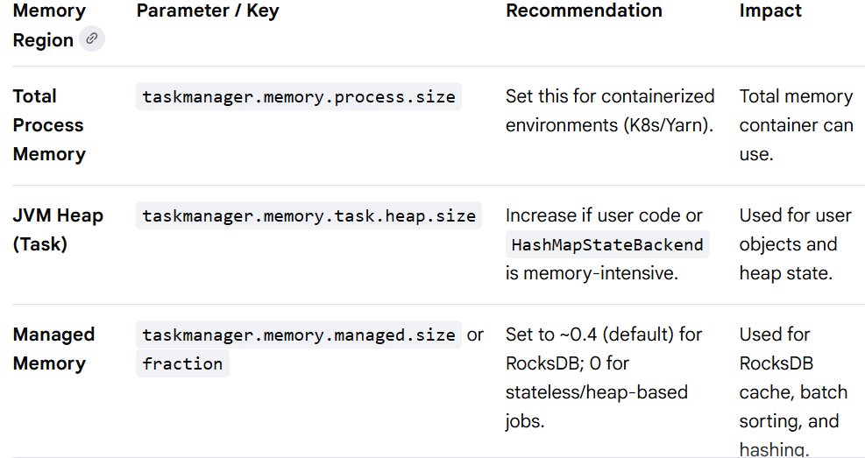
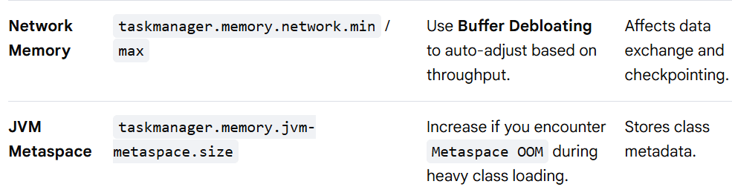
Distributed Stream Processing(using Apache Flink)
Apache Flink Performance Optimization & Tuning Techniques
Memory Management and Tuning

Slide 101
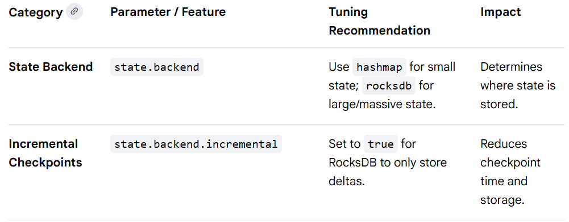
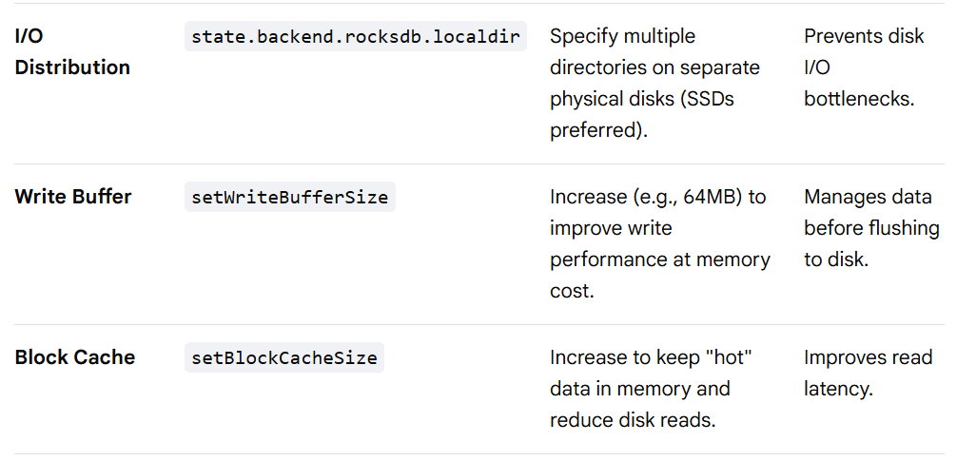
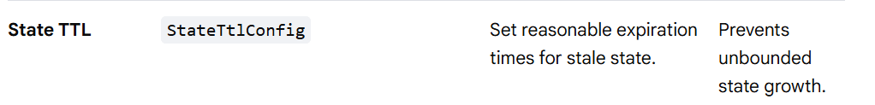
Distributed Stream Processing(using Apache Flink)
Apache Flink Performance Optimization & Tuning Techniques
State & Rock DB Optimzation

Slide 102
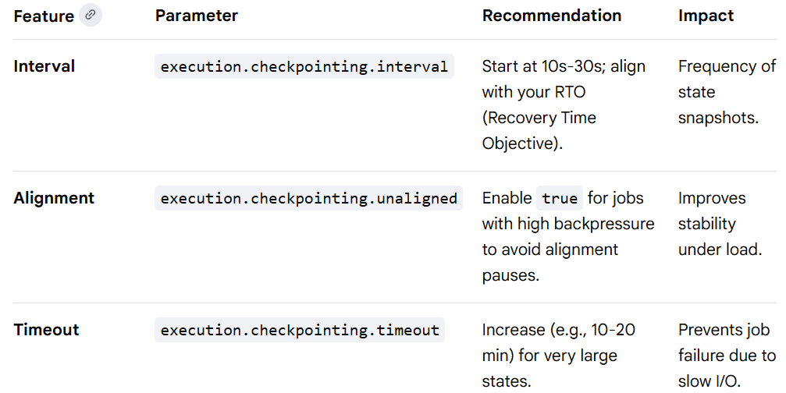
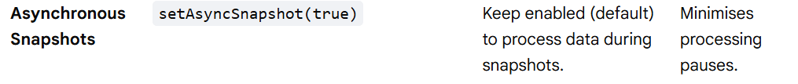
Distributed Stream Processing(using Apache Flink)
Apache Flink Performance Optimization & Tuning Techniques
Checkpointing and Fault Tolerance

Slide 103
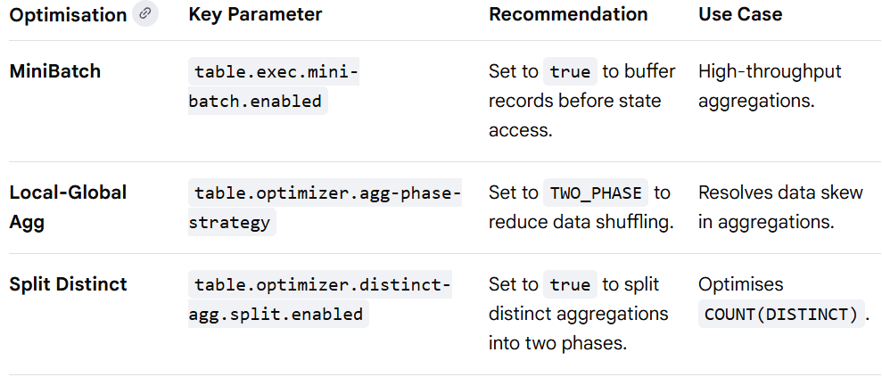

Distributed Stream Processing(using Apache Flink)
Apache Flink Performance Optimization & Tuning Techniques
SQL and Table API Optimization

Slide 104
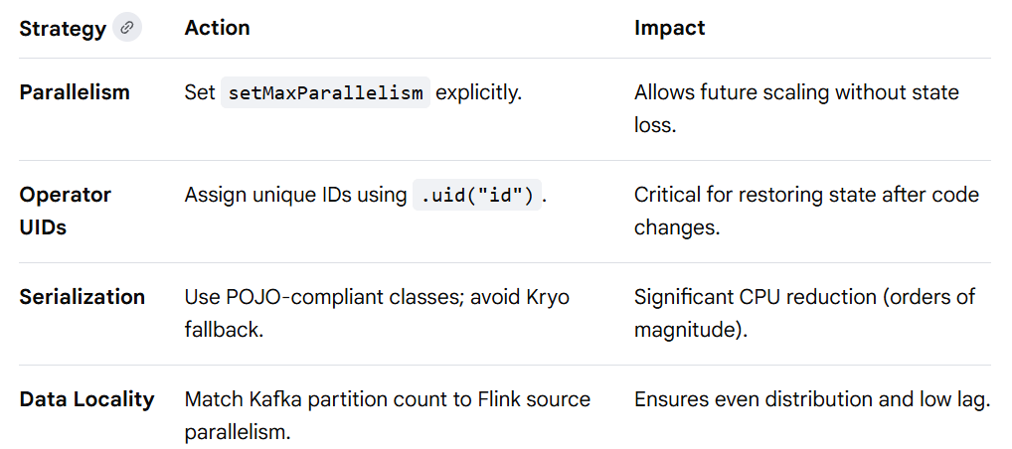
Distributed Stream Processing(using Apache Flink)
Apache Flink Performance Optimization & Tuning Techniques
Task and Resource Execution

Slide 105
Distributed Stream Processing(using Apache Flink)
For Further Exploration
Free E-Book - The ultimate data streaming guide - Kai Waehner
What's the difference between Processing Time and Event Time in Apache Beam
Is there a difference between on-line learning, incremental learning and sequential learning
Feature Deep Dive: Watermarking in Apache Spark Structured Streaming | Databricks Blog
Flink-Learning-Resources
Free Apache Flink Certification Course – DataFlair
Stream Processing with Apache Flink
Flink for the Apache Modern Data Stack
Apache Flink Documentation | Apache Flink
Apache Flink - Internal architecture of pyflink - Stack Overflow
Kafka for Architects - Katya Gorshkova
Resources for Apache Kafka, Data Streaming, Apache Flink, and More
Awesome-Flink
Streamdb-Readings
Exploring Flow Architectures | Microsoft Learn
Streaming Systems[Book]
Grokking Streaming Systems
Messages vs Stream
Azure Stream Analytics documentation - Azure Stream Analytics | Microsoft Learn

Slide 106
Distributed Data Pipeline using Apache Airflow
Apache Airflow Architecture
High-level logical flow
+-------------------+
| User |
+---------+---------+
|
v
+---------------+
| Web Server |
| (UI / API) |
+-------+-------+
|
v
+---------------+
| Metadata DB |
| (Postgres / |
| MySQL etc.) |
+-------+-------+
^
|
+-------+-------+
| Scheduler |
+-------+-------+
|
creates task instances
|

Slide 107
Distributed Data Pipeline using Apache Airflow
Apache Airflow Architecture
High-level logical flow
|
v
+-----------------+------------------+
| |
v v
+--------------+ +--------------+
| Workers | | Workers |
| (Celery/K8s) | | (Celery/K8s) |
+------+-------+ +------+-------+
| |
+-------------execute tasks----------+
|
v
External Systems
(S3, GCS, Spark, DBs, APIs, ML, etc.)
🏗️ Core Components
1. DAG Files (Directed Acyclic Graphs)
What they are
Python files defining workflows.
Contain:
DAG definition
Tasks

Slide 108
Distributed Data Pipeline using Apache Airflow
Apache Airflow Architecture
🏗️ Core Components
1. DAG Files (Directed Acyclic Graphs)
Contain:
Dependencies
Scheduling rules
Key points
Stored in a shared folder (dags/)
Parsed continuously by Scheduler & Webserver
Declarative: what to run, not how infrastructure runs it
Example conceptually:
extract_data >> transform_data >> load_data
2. Web Server
Purpose
Provides UI + REST API
Responsibilities
Displays DAGs
Shows task logs & status
Allows:
Manual DAG trigger
Pause/resume DAGs
Clear tasks
Reads everything from Metadata Database

Slide 109
Distributed Data Pipeline using Apache Airflow
Apache Airflow Architecture
🏗️ Core Components
2. Web Server
Important
Does NOT execute tasks.
Purely visualization + control plane.
3. Metadata Database
Purpose
Single source of truth.
Usually:
PostgreSQL (production)
MySQL
Stores:
DAG states
Task instances
Run history
Connections
Variables
XComs
User info
Think of it as:
Airflow’s brain + memory
Every component talks to it.

Slide 110
Distributed Data Pipeline using Apache Airflow
Apache Airflow Architecture
🏗️ Core Components
4. Scheduler (Most Critical Component)
Purpose
Decides what should run and when.
Responsibilities
Parses DAGs
Determines runnable tasks
Creates Task Instances
Pushes tasks to executor
Monitors task heartbeats
Handles retries & SLA misses
Internally:
DAG → Task → TaskInstance → Executor Queue
If Scheduler stops → Airflow is effectively dead.
5. Executor (Execution Strategy)
Defines HOW tasks are executed.
Common types:
a) SequentialExecutor (local/dev only)
1 task at a time
b) LocalExecutor
Multiple processes on same machine
Good for small setups.

Slide 111
Distributed Data Pipeline using Apache Airflow
Apache Airflow Architecture
🏗️ Core Components
5. Executor (Execution Strategy)
c) CeleryExecutor (distributed)
Scheduler → Redis/RabbitMQ → Workers
Defines HOW tasks are executed.
d) KubernetesExecutor
Each task = new Kubernetes Pod
Very cloud-native.
e) CeleryKubernetesExecutor
Hybrid of Celery + K8s.
6. Workers (Task Runners)
Purpose
Actually execute your Python operators.
They:
Pull tasks from executor queue
Run task code
Stream logs
Update DB with status
Stateless machines.
You scale Airflow mainly by adding workers.

Slide 112
Distributed Data Pipeline using Apache Airflow
Apache Airflow Architecture
🏗️ Core Components
7. Message Broker (Celery only)
Redis or RabbitMQ.
Used when:
Executor = CeleryExecutor
Flow:
Scheduler → Broker → Workers
No broker needed for KubernetesExecutor.
8. Triggerer (Deferrable Operators – Airflow 2+)
Used for async tasks (sensors, waiting jobs).
Instead of blocking workers:
Worker → Triggerer → resumes task later
Massively improves scalability.
9. Logs Storage
Where task logs live:
Local filesystem
S3 / GCS / Azure Blob
Webserver reads logs from here.
N.B. - As of Feb 2026, DAG(s) can be written only in Python while the tasks can be written in almost any language including C#/Java/Python etc using KubernetesPodOperator(infact, you can run most scripts written in languages like Javascript, Go etc also using BashOperator).

Slide 113
Distributed Data Pipeline using Apache Airflow
Apache Airflow Architecture
🔁 Complete Runtime Flow (Step-by-Step)
1. DAG written in Python
2. Scheduler parses DAG
3. Scheduler creates TaskInstance
4. Executor queues task
5. Worker picks task
6. Worker executes operator
7. Result written to Metadata DB
8. Logs written to storage
9. Webserver shows status
🧠 Mental Model
Think of Airflow like this:
DAG → Blueprint
Scheduler → Brain
Metadata DB → Memory
Executor → Strategy
Workers → Muscles
Webserver → Face
✅ Production Deployment Usually Looks Like
Webserver (2 replicas)
Scheduler (1–2 replicas)
Metadata DB (Postgres)
Redis/RabbitMQ (if Celery)
Multiple Workers / K8s Pods
Shared DAG + Log storage

Slide 114
Distributed Data Pipeline using Apache Airflow
Data Ingestion Techniques in Apache Airflow
Airflow REST API: External systems can make an HTTP POST request to the Airflow API's dag. Runs endpoint or the assetEvents (for Airflow 2.9+) endpoint to trigger a specific DAG.
How it works: An external service (e.g., an AWS Lambda function triggered by an S3 file upload) calls the API to initiate a DAG run, optionally passing configuration data in the request body, which the DAG can then use.
Best for: Real-time, highly dynamic external triggers where the external system is responsible for making the API call.
Datasets (Assets): Airflow uses the concept of "Assets" (formerly Datasets) to manage data dependencies and trigger downstream DAGs when data is updated.
How it works: When an external event occurs (e.g., a new file is created in S3), an external mechanism (like an AWS Lambda function) can call the Airflow API's create asset event endpoint, which then signals Airflow to schedule any DAGs that have that asset defined as a schedule.
Message Queues: Airflow can integrate with message queues like Apache Kafka, Amazon SQS, or RabbitMQ to enable event-driven scheduling.
How it works (Poll-based): Airflow's internal Triggers (running in the Triggerer component) can poll the message queue for new messages. When a message is detected, it triggers the relevant DAG run.
How it works (Push-based via external logic): An external application (a "dispatcher" or consumer) can monitor the queue and, upon receiving a message, use the Airflow REST API to trigger the appropriate DAG.
Sensors with Deferrable Operators: For scenarios in Airflow 2+ where the event timing is unpredictable, sensors can be used in a deferrable manner.
How it works: A sensor task in a DAG is created to wait for a specific external condition to be met (e.g., a file to appear). When the condition isn't met, the task is deferred to a lightweight Triggerer process, freeing up a worker slot until the event occurs, at which point the task resumes. This is technically a polling mechanism, but it is

Slide 115
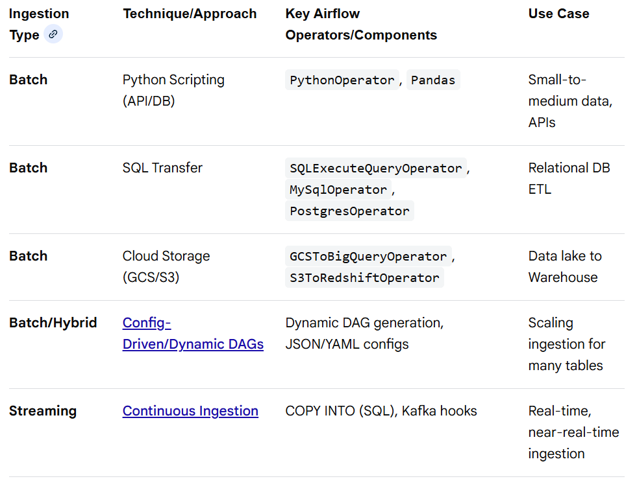
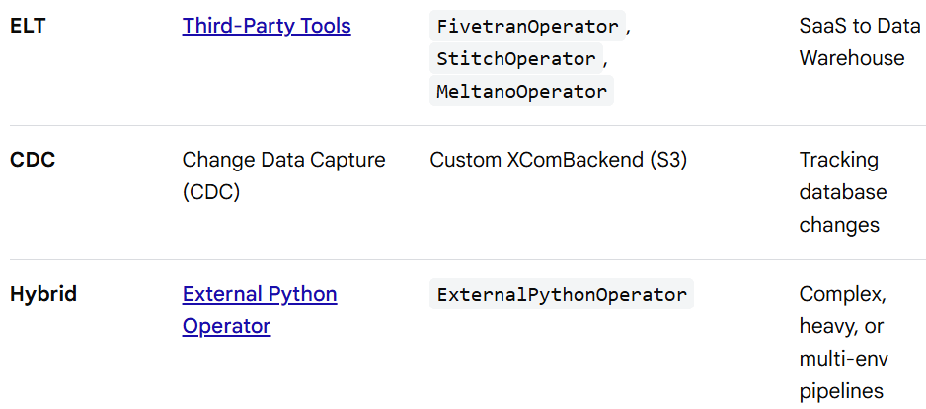
Distributed Data Pipeline using Apache Airflow
Data Ingestion Techniques in Apache Airflow
Sensors with Deferrable Operators: For scenarios in Airflow 2+ where the event timing is unpredictable, sensors can be used in a deferrable manner.
How it works: A sensor task in a DAG is created to wait for a specific external condition to be met (e.g., a file to appear). When the condition isn't met, the task is deferred to a lightweight Triggerer process, freeing up a worker slot until the event occurs, at which point the task resumes. This is technically a polling mechanism, but it is resource-efficient and mimics event-driven behavior.
Other High Level Techniques

Slide 116
Distributed Data Pipeline using Apache Airflow
Apache Airflow Integration Architecture
High Level Integration Architecture (Logical View)
Users / BI / APIs
|
v
+------------------+
| Airflow UI |
+---------+--------+
|
v
Metadata Database
^
|
Airflow Scheduler
|
creates TaskInstances
|
v
------------------------------------------------
| | | |
v v v v
Kafka Spark Jobs Flink Jobs DQ / Lineage
(Producers/ (Batch / ML) (Streaming) (GE / OL)
Consumers)

Slide 117
Distributed Data Pipeline using Apache Airflow
Apache Airflow Integration Architecture
High Level Integration Architecture (Logical View)
|
v
Data Lake / Warehouse
(S3/GCS/HDFS/BigQuery/Snowflake)
|
v
Analytics / ML
Airflow is the control plane, not the compute engine.
🧠 Core Philosophy
Airflow does NOT process data.
It orchestrates:
when Spark runs
when Flink starts
when Kafka topics are consumed
when data quality checks execute
when lineage metadata is emitted
1️⃣ Airflow + Kafka Integration
Purpose
Used for:
Event-driven pipelines
Triggering DAGs from streams
Consuming messages for downstream batch

Slide 118
Distributed Data Pipeline using Apache Airflow
Apache Airflow Integration Architecture
1️⃣ Airflow + Kafka Integration
Typical Pattern
Kafka Topic → Airflow Sensor → DAG Trigger → Spark/Flink
How it works
Airflow uses:
Kafka sensors
Kafka producers
Deferrable operators (Triggerer)
Flow:
Kafka receives event
↓
Airflow KafkaSensor waits
↓
Scheduler triggers DAG
↓
Spark/Flink job launched
Important
Airflow does NOT replace Kafka consumers.
Kafka = data movement
Airflow = orchestration

Slide 119
Distributed Data Pipeline using Apache Airflow
Apache Airflow Integration Architecture
2️⃣ Airflow + Spark Integration (Batch / ML)
Role of Spark
ETL
Feature engineering
Model training
Large batch transformations
Integration Methods
Airflow uses:
SparkSubmitOperator
LivyOperator
KubernetesPodOperator (Spark on K8s)
Flow
Airflow Scheduler
↓
SparkSubmitOperator
↓
Spark Driver
↓
Spark Executors
↓
Results → Data Lake/Warehouse
Airflow tracks:job state, retries, SLA, downstream dependencies etc
Spark handles: compute, shuffles, memory

Slide 120
Distributed Data Pipeline using Apache Airflow
Apache Airflow Integration Architecture
3️⃣ Airflow + Flink Integration (Streaming)
Role of Flink
Real-time aggregation
Stateful stream processing
CEP
Pattern
Airflow manages Flink job lifecycle:
Airflow → Start Flink Job
Airflow → Monitor Job
Airflow → Restart on failure
Flink continuously consumes Kafka.
Airflow only:
deploys
upgrades
Coordinates

Slide 121
Distributed Data Pipeline using Apache Airflow
Apache Airflow Integration Architecture
4️⃣ Airflow + Data Quality (Great Expectations)
Purpose
Prevent garbage data entering analytics.
Pattern
Spark/Flink finishes
↓
Great Expectations task runs
↓
Pass → continue DAG
Fail → stop + alert
Example Flow
Extract → Transform → Validate → Load
Validation happens before warehouse load.
Results stored in:
S3/GCS
Metadata DB
Data Docs

Slide 122
Distributed Data Pipeline using Apache Airflow
Apache Airflow Integration Architecture
5️⃣ Airflow + Data Lineage (OpenLineage + Marquez)
Purpose
Track:
dataset origins
transformations
consumers
Flow
Airflow Task Runs
↓
OpenLineage events emitted
↓
Marquez stores metadata
↓
Lineage UI visualization
Automatically captures:
inputs
outputs
job metadata
owners
Critical for governance.

Slide 123
Distributed Data Pipeline using Apache Airflow
Apache Airflow Integration Architecture
Full End-to-End Runtime Example
1. Kafka receives raw events
2. Airflow KafkaSensor detects volume threshold
3. DAG triggered
4. Spark batch ETL runs
5. Flink streaming job aggregates real-time metrics
6. Great Expectations validates curated tables
7. OpenLineage emits lineage
8. Marquez stores metadata
9. Data lands in warehouse
10. BI dashboards refresh
🏗️ Production Reference Architecture
Airflow:
- Webserver (2 replicas)
- Scheduler (1–2)
- Triggerer
- Workers (auto-scaled)
Streaming:
- Kafka Cluster
- Flink Cluster
Batch:
- Spark on YARN / Kubernetes

Slide 124
Distributed Data Pipeline using Apache Airflow
Apache Airflow Integration Architecture
🏗️ Production Reference Architecture
Governance:
- Great Expectations
- OpenLineage
- Marquez
Storage:
- S3 / GCS / HDFS
- Warehouse (Snowflake / BigQuery)
Observability:
- Prometheus
- Grafana
🎯 Key Design Principles
✅ Airflow is orchestration only
Never data processing.
✅ Streaming & Batch separation
Kafka/Flink = real time
Spark = batch
Airflow = coordinator
✅ Data Quality is a DAG stage, not afterthought
Always:
Transform → Validate → Publish
✅ Lineage is emitted automatically
No manual tracking.
✅ Stateless workers
Everything durable goes to external systems.

Slide 125
Distributed Data Pipeline using Apache Airflow
Apache Airflow Integration Architecture
⚠️ Common Mistakes
❌ Using Airflow as streaming processor
❌ Running Spark inside Airflow workers
❌ Skipping quality gates
❌ No lineage
❌ Tight coupling between DAGs and compute
🧠 Mental Model
Think of Airflow as:
Distributed conductor of an orchestra
Kafka, Spark, Flink, GE, Marquez are musicians.
Airflow only coordinates timing.

Slide 126
Distributed Data Pipeline using Apache Airflow
For Further Exploration -
Exploring Airflow: First Impression from a Seasoned SSIS & ODI User
Apache Spark vs. Apache Airflow
Airflow vs Apache Flink
Data Orchestration Tools: A Comprehensive Look at Apache Airflow, AWS Glue, and ADF
Apache Airflow Resource I
Apache Airflow Resource II
Executors in Apache-Airflow
The Complete Hands-On Introduction to Apache Airflow 3 | Udemy
Apache Airflow | A Real-Time & Hands-On Course on Airflow | Udemy
Apache Airflow: The Operators Guide | Udemy
Data Pipelines with Apache Airflow®
Mastering Workflow Management with Apache Airflow
Apache Airflow Demystified: Build, Schedule, and Monitor Data Pipelines
Apache-Airflow-Best-Practices

Slide 127
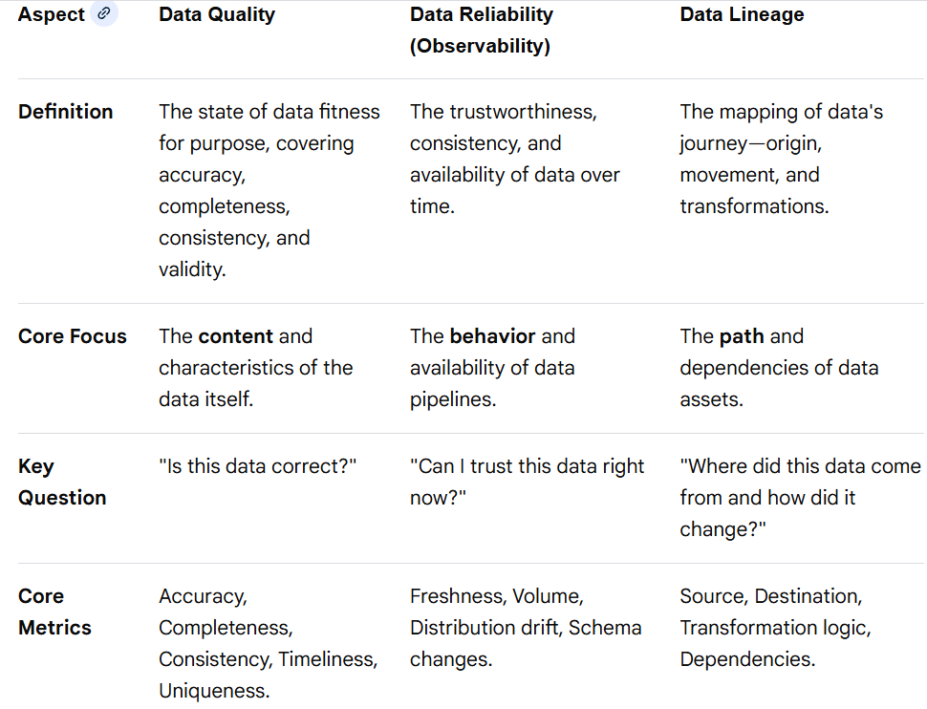
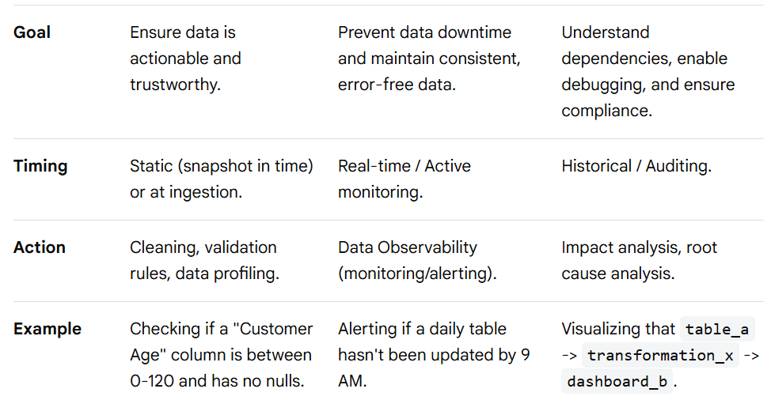
Trusted Data Engineering
Data Quality, Reliability, and Lineage form the foundation of trusted data engineering. Data Quality ensures data is accurate and fit for purpose (Accuracy, Completeness). Data Reliability ensures data is trustworthy and consistent over time. Data Lineage maps the lifecycle, tracing origins, transformations, and dependencies.
Comparison of Data Quality, Reliability, and Lineage

Slide 128
Trusted Data Engineering
Breakdown
Data Quality (The "What"): Focuses on the inherent characteristics of data. High-quality data is accurate, complete, consistent, unique, and timely.
Data Reliability (The "When"): Focuses on whether the data can be trusted over time. This is increasingly managed via Data Observability, which acts as a "smoke detector" for data systems, spotting issues like schema changes or unexpected volume drops.
Data Lineage (The "How"): Provides the context, showing how data moves from source to destination. It is critical for Impact Analysis (what breaks if I change this?) and Root Cause Analysis (why is this dashboard wrong?).
How They Work Together
Lineage helps identify which upstream data source is causing a quality issue. Reliability (observability) tells you that a table is not updating. Once you realize the data is unreliable, you use lineage to find the root cause, and data quality checks to fix the data.
For Further Exploration
Data Quality Fundamentals [Book]
Data-Quality-in-Practice
OpenLineage
OpenMetadata: #1 Open Source Metadata Platform

Slide 129
Data Observability
Data observability is the ability to monitor, measure, and manage the health and performance of data across its entire lifecycle, enabling organizations to proactively detect, resolve, and prevent data issues before they impact the business.
The Five Pillars of Data Observability
Data observability provides a comprehensive understanding of data health by focusing on five key pillars:
Freshness: Measures the timeliness of the data, ensuring it is up-to-date and updated at expected intervals.
Volume: Tracks the amount of data in a dataset or flowing through a pipeline to detect unexpected spikes or drops that might indicate issues like missing records or duplicate data.
Distribution: Monitors key statistical properties (mean, median, standard deviation) and the range of data values to identify anomalies or drift from expected patterns.
Schema: Tracks changes in the structure and organization of data (e.g., column additions/deletions, type changes) which can break downstream processes.
Lineage: Maps the data's journey from source to destination, including all transformations and dependencies, which is crucial for root cause analysis and impact assessment.
The Role of Data Observability
Data observability is crucial for maintaining data reliability and trust. It differs from traditional monitoring and data quality by:
Proactive vs. Reactive: Observability uses machine learning to automatically detect both known and unknown issues (anomalies) in real-time, in contrast to traditional data quality's reactive, rule-based approach.
Context and Scope: It provides deep context (lineage, ownership, recent changes) and end-to-end visibility across the data ecosystem, not just isolated data points or pipeline metrics.
Faster Resolution: By providing insights into where and why an issue occurred, it drastically reduces the Mean Time to Resolution (MTTR), minimizing data downtime.

Slide 130
Data Observability
Data Observability as Code (DataOps)
Data Observability as Code (OaC) is an extension of the DataOps and Infrastructure as Code (IaC) principles, where the configuration and management of data observability settings are defined and managed through code (e.g., YAML files).
Version Control: Configuration files for monitors, alerts, and dashboards are stored in version control systems (like Git), allowing for change tracking, collaboration, and easy rollbacks.
Consistency and Automation: OaC ensures consistent observability configurations across different environments (development, staging, production), reducing manual errors and accelerating deployment.
Integration with CI/CD: It integrates seamlessly into Continuous Integration/Continuous Deployment (CI/CD) pipelines, meaning observability checks become an integral part of the development and deployment process, catching issues earlier (shifting left).
Implementation Guide and Best Practices
Implementing a robust data observability practice involves strategic planning and a phased approach:
Define Clear Objectives: Identify the business value you aim to achieve, such as ensuring a critical executive dashboard is always accurate or protecting an ML model from data drift.
Identify Critical Data Assets: Start with high-impact or high-risk tables and pipelines that would cause significant business pain if they failed.
Implement Layered Monitoring:
Crawl: Begin with basic, automated monitoring for freshness, volume, and schema across your data environment.
Walk: Add more sophisticated, custom monitors and integrate with incident response workflows.
Run: Focus on prevention and use advanced features like automated root cause analysis and AI-driven anomaly detection to continuously improve reliability.
Assign Clear Ownership: Define who owns which data products and pipelines to ensure clear accountability when issues arise.

Slide 131
Data Observability
Implement Layered Monitoring:
Establish SLAs and SLOs: Define Service Level Agreements (SLAs) and Service Level Objectives (SLOs) to set clear expectations for data reliability with stakeholders.
Integrate with Existing Workflows: Ensure your observability tools integrate with existing data orchestration tools (like dbt, Airflow) and communication platforms (like Slack or PagerDuty) to streamline issue resolution.
Foster a Culture of Learning: After an incident is resolved, conduct a post-mortem to understand what went wrong and update tests or monitors to prevent recurrence.
Leading commercial tools include Metaplane, Monte Carlo, and Datafold which offer end-to-end solutions, while open-source options like OpenMetadata and OpenLineage provide a foundation for building custom solutions.
For Further Exploration
Pioneering Data Observability: Data, Code, Infrastructure, & AI
Top 14 Data Observability Tools in 2026: Key Features
Complete guide to understanding data observability in 2024
Fundamentals-of-Data-Observability
Data Observability for Data Engineering | Data | eBook
Data Observability, The Reality: Understand the Why and How
Observability as code | Grafana documentation

Slide 132


Data Latency vs Freshness

Slide 133
Data Latency vs Freshness
Breakdown
1. Data Latency: The Pipeline Speedometer
Data latency is a technical, infrastructure-focused metric. It measures how quickly your data pipeline (Extract, Transform, Load - ETL) moves data from the source (e.g., a website user action) to the destination (e.g., a data warehouse like Snowflake or Redshift).
Low Latency (Real-time/Streaming): Data flows within seconds or milliseconds.
High Latency (Batch): Data flows daily or hourly (e.g., nightly batch jobs).
Goal: To reduce the "bottleneck" in the ingestion process.
2. Data Freshness: The Data Compass
Data freshness is a data quality dimension focusing on the "age" of the data when a user or machine learning model consumes it. It compares the data against the present moment.
Fresh Data: Describes the real world right now.
Stale Data: A, accurate, but old record (e.g., a 1-hour old stock price is useless for high-frequency trading).
Goal: To ensure the data reflects the current state of reality.
The "Dangerous Quadrant": Fast + Stale
A major point of confusion is thinking that fast (low latency) equals fresh (high quality). However, a system can be Fast but Stale.
Fast + Stale (Dangerous): Your dashboard loads in 10ms (Low Latency), but it is showing yesterday's sales figures (Low Freshness). The system feels responsive but is providing outdated information, which is dangerous.
The Ideal: Fast + Fresh. Low latency pipelines that run continuously, ensuring the data in your BI tool is never more than a few seconds or minutes old.

Slide 134

Data Latency vs Freshness
Real World Patterns
Best Practices for Data Teams
Monitor Both: Track latency (pipeline speed) and data age (time since last record) in your observability platform.
Define SLAs: Set Service Level Agreements (SLAs) for data freshness based on business needs (e.g., "Customer data must be < 5 mins old").
Minimize Hops: Reduce the number of steps in your ETL pipeline; every step adds latency and reduces freshness.
Use Streaming/CDC: Use Change Data Capture (CDC) or streaming platforms (e.g., Kafka, Flink) to move away from batch-based bottlenecks.

Slide 135
Data Migration, Backup & Restore
Data Migration
Basically, for any type of (huge) Data Migration, should use E(T)L/EL(T) tools(custom-built or OSS/Free or COTS) with capabilities like -
a) Good Observability
b) Good Resiliency
c) Good Performance
d) Good (Horizontal) Scalability
e) Validating correctness of source & destination data(after migration), maybe using counts, hashes etc
Although other NFRs(e.g. Security, Config driven etc) can also be important based on contextual requirements, but the above 5 NFRs are kind of bare minimum needed to be addressed in most Data Migration projects(especially, if the Data volume is huge).For Autoscaling, can take a API based approach alongwith some Background Service in the front.
By the way, there are high chances that the source & destination primary key doesn’t have any direct mapping & so you may need to use some Business Functionality Specifying Column(s) of the tables based uniqueness (logic) to identify a record to migrate(insert/update) from source to destination. Schema versioning also can become important for certain Data Migrations.
Also, if you have a CreatedBy Audit column in the destination table then that can turn out to be very useful w.r.t data migration since say for normal process you can set CreatedBy to “system” & for data migration tasks can be set to “data migration system”(or something else that identifies the data migration task) & that can ultimately help in testing.
Also, deletion of source data might be needed after migration(if applicable) & as part of prod release rollback plan, if something goes wrong then the whole migrated data may need deletion & for that its better to check upfront that how much time atleast a small sample of the actual data size takes & then extrapolate if needed.

Slide 136


Data Migration, Backup & Restore
Data Migration Techniques(Moving Data)

Slide 137

Data Migration, Backup & Restore
Data Backup Techniques(Protecting Data)

Slide 138

Data Migration, Backup & Restore
Data Restore & Recovery Techniques(Restoring Data)

Slide 139
Data Migration, Backup & Restore
Key Strategies for Success
3-2-1 Rule: Keep 3 copies of data, on 2 different media, with 1 copy off-site.
4-3-2 Rule: 4 copies, 3 locations, 2 off-site (improved 3-2-1 for ransomware protection).
Pre-migration Test: Always validate data in a staging environment that mirrors production before going live.
Automation: Utilize tools to automate backups and migration tasks to reduce human error.
For Further Exploration –
The Secret Sauce of the Document Migration Process - OpenText Blogs
Fluent migrations framework for .NET | FluentMigrator documentation
Azure Database Migration Service | Microsoft Azure
Cloud Database Migration - AWS Database Migration Service (AWS DMS) - AWS
The Essential Guide to Database Backup: Tips & Strategies | Metis
Back Up and Restore of SQL Server Databases - SQL Server | Microsoft Learn
Practical Data Migration

Slide 140
Probabilistic Data Structures
Probabilistic data structures are algorithms that provide fast, memory-efficient, and approximate answers to queries on massive datasets, sacrificing absolute accuracy for speed and space. They use randomization/hashing to offer near-perfect results, making them ideal for high-throughput, real-time applications where minor errors are acceptable, trading perfect accuracy for significantly lower memory usage and faster processing speeds.. They are foundational in Big Data, streaming analytics, and networking, as they allow handling billions of elements in a few kilobytes or megabytes of memory.
Why We Need Them
Memory Efficiency: They can represent massive datasets in just a few kilobytes or megabytes, handling billions of elements in space where traditional structures (like Sets or HashMaps) would exceed memory constraints.
Speed: Operations like insertion and lookup are often , where is the number of hash functions, providing constant time complexity independent of data size.
Handling Large Scale Data: They are essential for streaming data or big data scenarios (e.g., counting unique users, checking membership in a huge list).
Core Concepts and Components
Hashing: Maps arbitrary data to a specific, often randomized, location.
Bit Array/Sketch: A compact, fixed-size representation of data, rather than storing the data itself.
False Positive (FP): Claiming an item is present when it is not (permitted).
False Negative (FN): Claiming an item is absent when it is present (NOT permitted).
Error Rate (ER): The probability of a false positive.

Slide 141


Probabilistic Data Structures

Slide 142
Probabilistic Data Structures
Detailed Analysis by Category
1. Membership Queries (Is in Set ?)
Bloom Filter: Uses bits and hash functions. To insert, hash times and set bits to 1. To query, check if all
bits are 1. It may say "Yes" when it's "No" (false positive), but never "No" when it's "Yes".
Cuckoo Filter: More efficient than Bloom filters for deletion. It stores a "fingerprint" of the element in one of two hash-mapped buckets. If a bucket is full, it "cuckoos" existing items to their alternative location.
Use When: Cache filtering, Database lookup (avoiding disk), Network packet routing.
2. Cardinality Estimation (How many unique in ?)
HyperLogLog (HLL): Estimates cardinality by analyzing the maximum number of leading zeros in the binary representation of hashed items. It is extremely space-efficient, often providing ~2% error using only 1.5KB of memory to count over 1 billion items.
Use When: Tracking unique visitors (UV), Counting unique IP addresses in logs, Web analytics.
3. Frequency Estimation (How many times did occur?)
Count-Min Sketch: A 2D array (depth , width ) where each row uses a different hash function. Updates increment counters at positions. Queries return the minimum value among the hashed positions, ensuring the estimate is never less than actual.
Use When: Identifying "Heavy Hitters" (top 1% popular items), Network traffic monitoring, Streaming data analysis.
4. Similarity Estimation (How similar are Set A and Set B?)
MinHash: Uses hash functions to produce a signature of a set. The probability that the minimum hash value of two sets is the same equals their Jaccard similarity.
Use When: Detecting duplicate documents, Content recommendation systems.

Slide 143
Probabilistic Data Structures
Implementation Patterns & Gotchas
Parameter Tuning: Accuracy depends on size (m) and hash functions (k). High accuracy = higher memory.
Hashing Matters: Using weak or non-independent hash functions increases false positives.
Idempotency: Most PDS are idempotent—adding the same item multiple times does not change the result (like in HLL).
Merging: HLL and Bloom Filters can be merged (unioned) easily, which is useful in distributed systems (e.g., merging counters from 10 different servers).
Summary of When to Use What
Is the item definitely not in the set? - Bloom Filter (fastest/smallest).
Does the item exist and need to be deleted? - Cuckoo Filter.
How many unique users visited in 1 second? - HyperLogLog.
What are the top 100 search queries? - Count-Min Sketch.
Is this document similar to another? - MinHash.
What is the 99th percentile latency of my API? - T-Digest.
Common Patterns and Best Practices
Scaling: Use a "Scalable Bloom Filter" (cascade of filters) if the number of items is unknown.
Mergeability: HLL and CMS are mergeable. You can run them on multiple servers and combine the results.
Parameters: Always calculate the optimal size (m) and hash functions (k) based on expected items (n) and desired error rate (e).
Libraries: Instead of manual implementation, use battle-tested libraries like Redis Bloom, Google Guava, or Apache Datasketches.

Slide 144
Probabilistic Data Struvtures
For Further Exploration(Probabilistic Data Structures and some other Advanced Niche Topics)
Introduction to the Probabilistic Data Structure – GeeksforGeeks
Probabilistic Data Structures Decoded: Enhancing Performance in Modern Computing
What are probabilistic data structures? - Stack Overflow
Probabilistic Data Structures Simplified | by Anik | Medium
Advance Data Structures for Data Engineering — Part II
Probabilistic | Docs
Algorithms and Data Structures for Massive Datasets eBook
Probabilistic Data Structures and Algorithms for Big Data Applications eBook
Probabilistic Data Structures for Blockchain-Based Internet of Things Applications
Category:Probabilistic data structures – Wikipedia
IO_Efficient_Computation
CPS 296 Advanced Topics in CS
External memory algorithm – Wikipedia
External_Memory_Algos.pdf
External.pdf
Vit.IO_survey.pdf

Slide 145
Thank You

